Slide 1
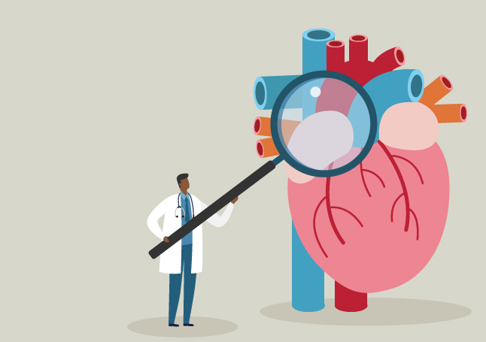
The role of NOTCH1 in Aortic Valve Disease (AoVD1)
Heart Valve Malformations:
Mario Bertogliat
Gen 564
1

Slide 2
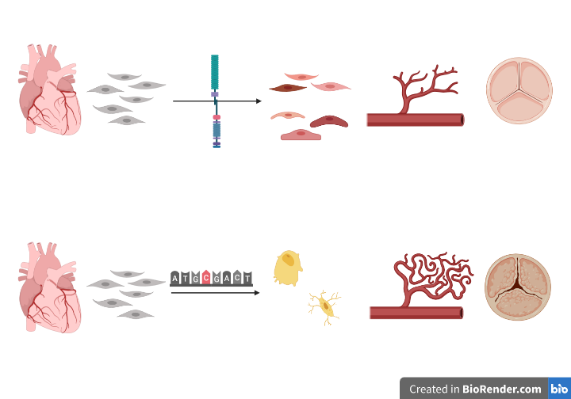
What is Aortic Valve Disease 1 (AoVD1)?
NOTCH1 signaling
Developing heart
Proper aortic valve formation and vascularization
NOTCH1 mutation
Developing heart
Osteoblast formation and aortic valve calcification
2

Slide 3
How does AoVD1 manifest?
Heart Murmur
Chest pain
Arrhythmia
Short of breath
3

Slide 4
Why did I pick AoVD1?
Transapical
Transaortic
Transfemoral
4

Slide 5
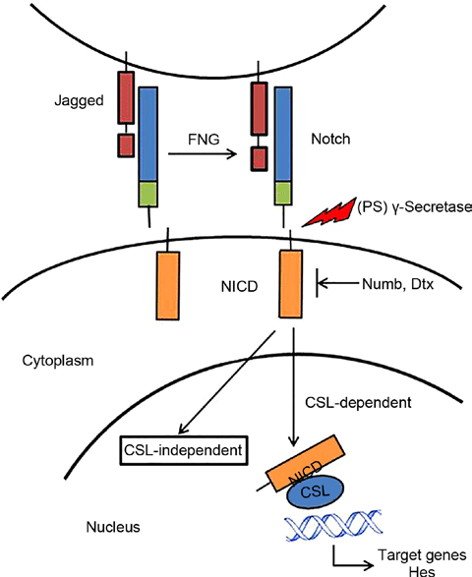
NOTCH1 is associated with AoVD1
EGF and EGF CA
NL
NOD
NODP
ANK
DUF
Ligand Binding
Regulation
Dimerization
Signal Transduction
Molecular function
Biological process
Cellular component
5

Slide 6
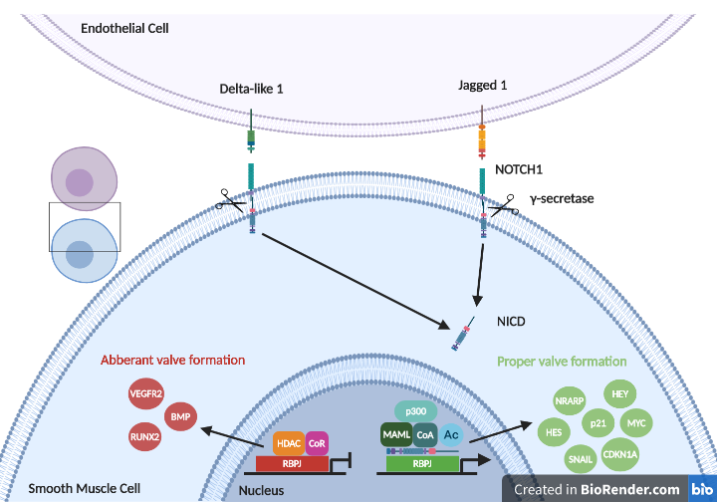
The NOTCH Signaling Pathway
6

Slide 7
NOTCH1 is a conserved transmembrane receptor
2555 AA -%
EGF and EGF CA
NL
NOD
NODP
ANK
DUF
Human
2531 AA 90.73%
Mouse
2436 AA 67.03%
Zebrafish
2703 AA 49.37%
Fruit Fly
1429 AA 27.67%
C. Elegans
7

Slide 8
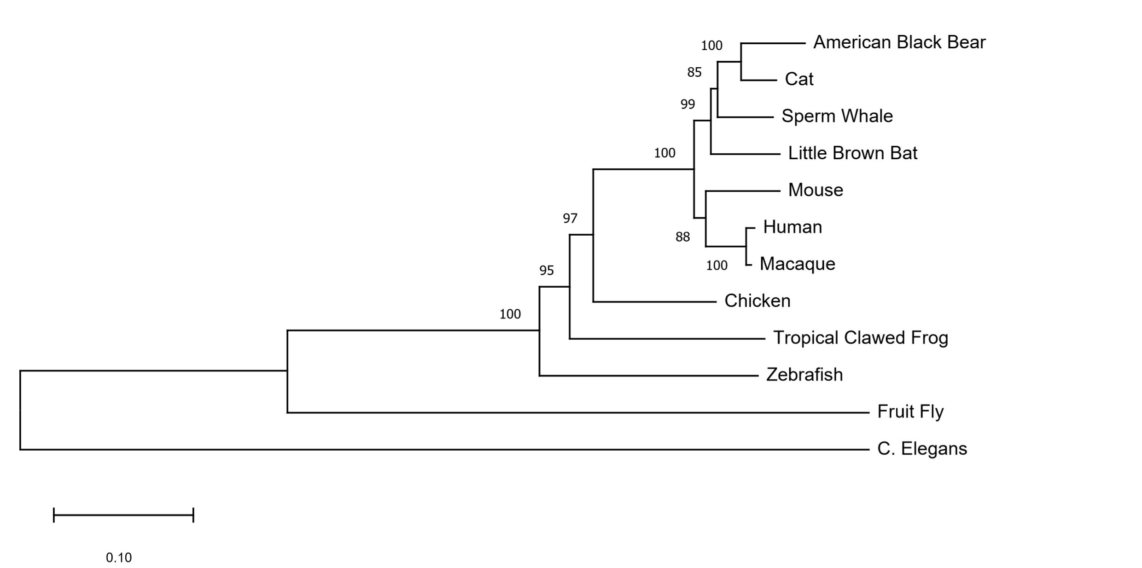
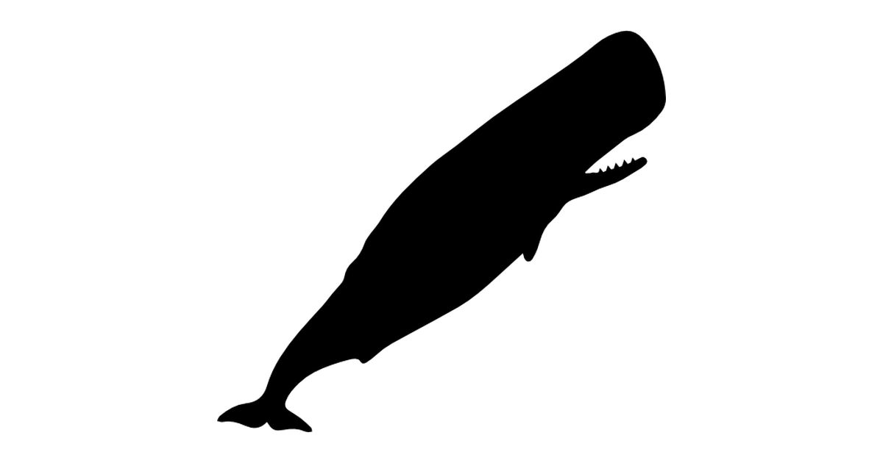
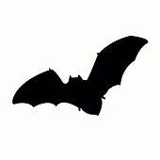
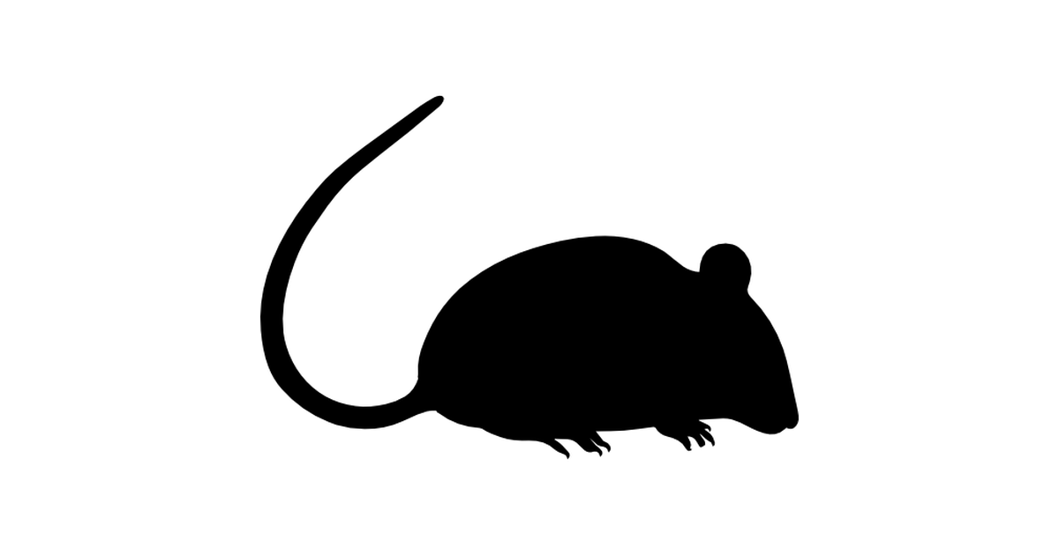
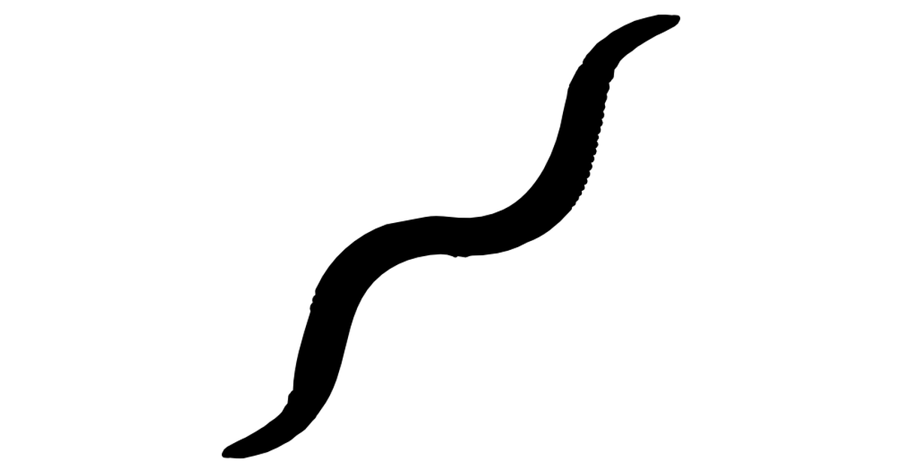
NOTCH1 is well conserved among vertebrates with complex cardiovascular systems
Muscle aligned neighbor-joining method
8

Slide 9
Zebrafish can be used to study heart development
Human
Zebrafish
7
9

Slide 10
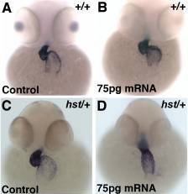
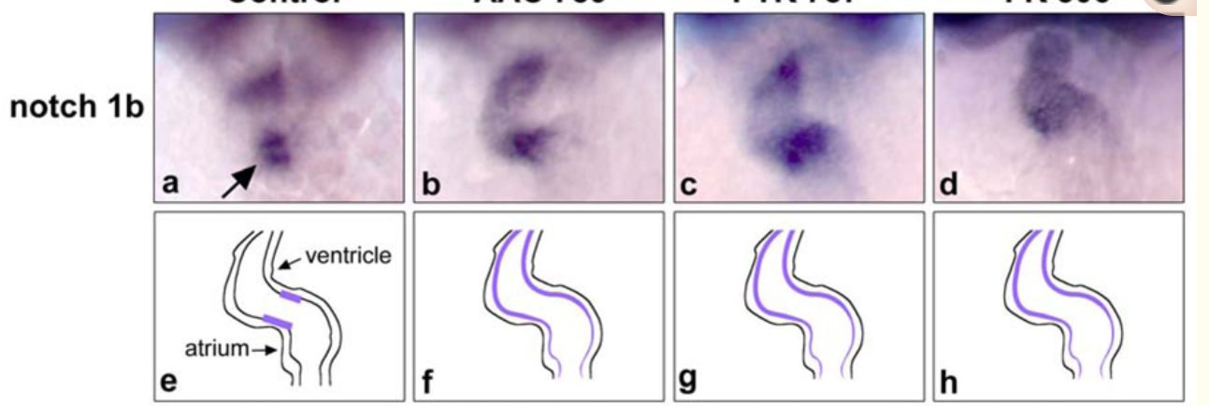
Zebrafish can be used to study heart development
10

Slide 11
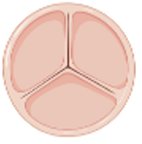
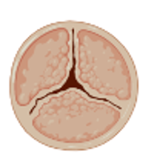
What is the gap in knowledge?
Which EGF-like calcium binding domains are key to aortic valve formation and why?
11

Slide 12
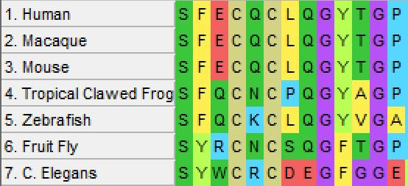
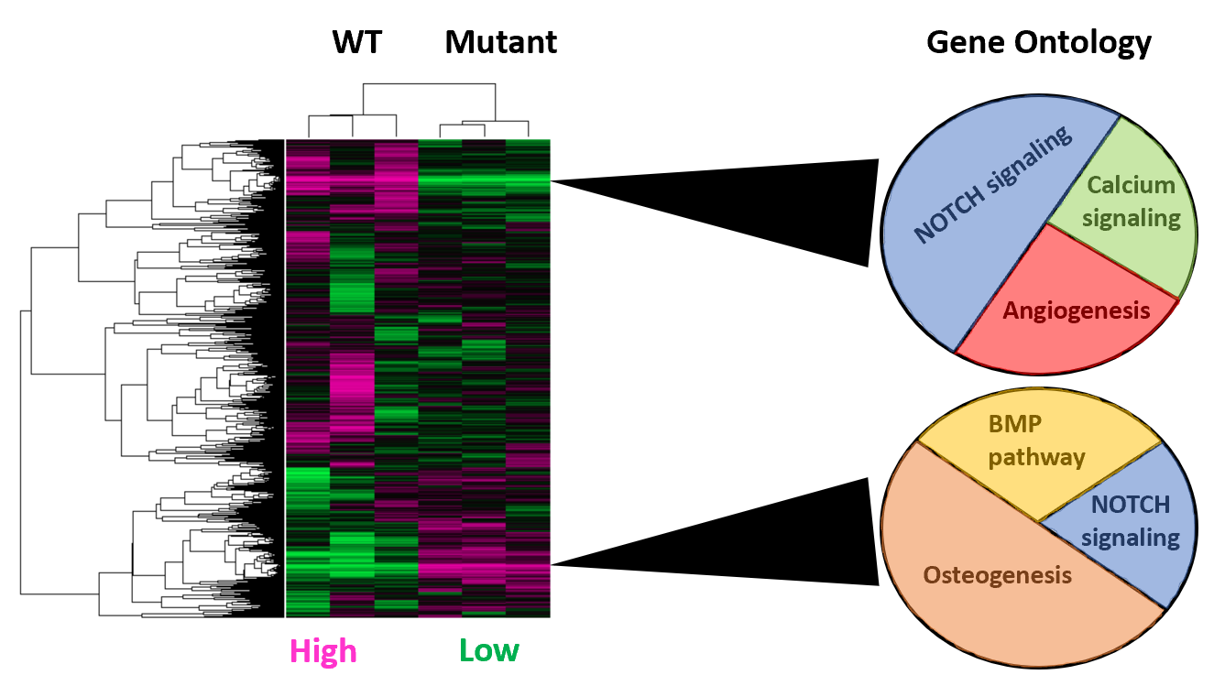
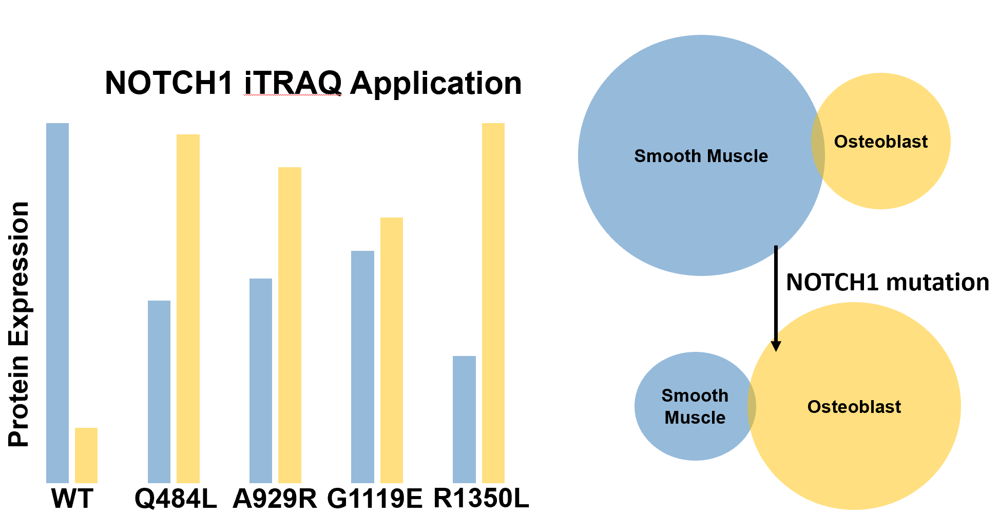
What is my primary goal?
Determine how mutations in the EGF-like calcium binding domains lead to aortic valve calcification
AIM 1
AIM 2
AIM 3
Identify and mutate conserved amino acids in EGF-like domains
Identify expression changes in response to EGF-like mutations
Identify protein changes in response to EGF-like mutations
12

Slide 13
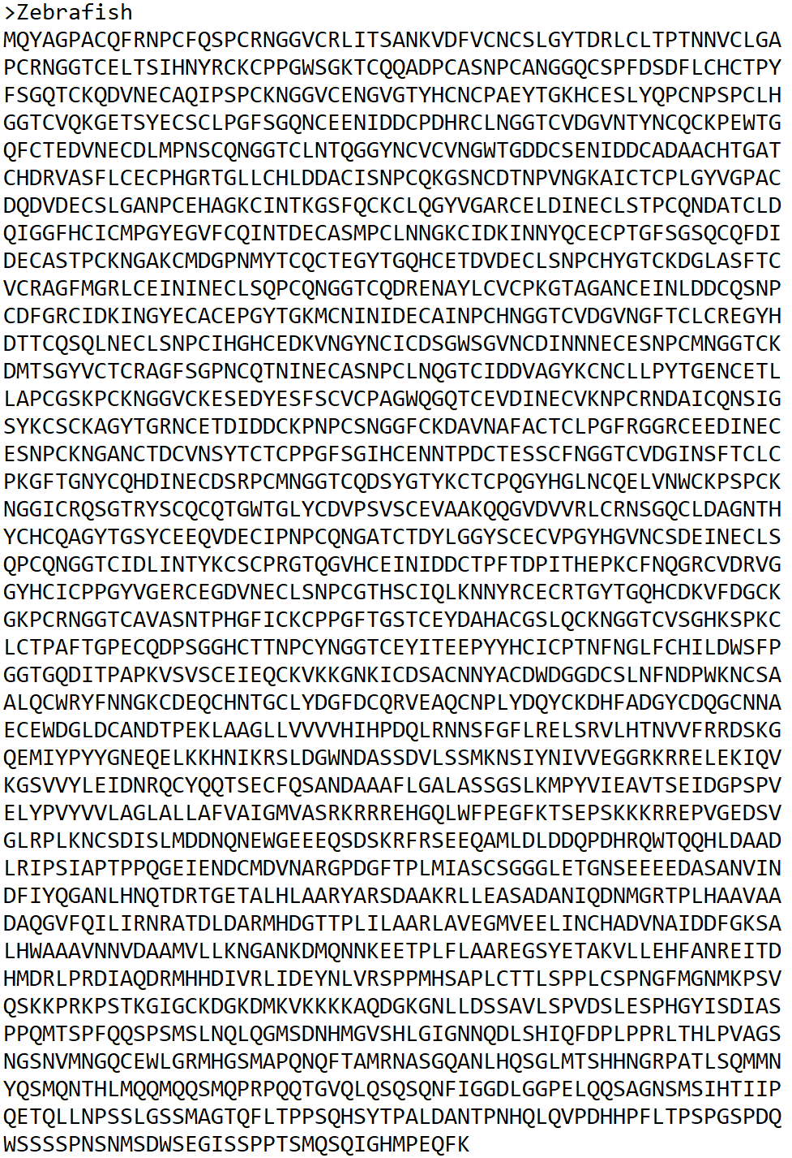
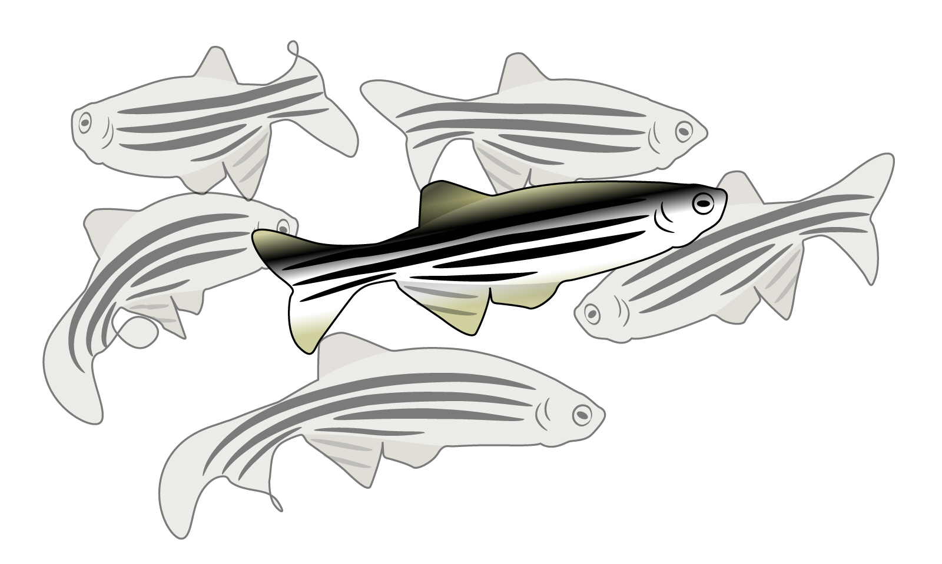
Hypothesis 1: NOTCH1 EGF-like calcium binding domains conserved in organisms with complex cardiovascular systems (hearts) are critical for aortic valve development
FASTA
MEGA
CRISPR
SCREEN
13

Slide 14
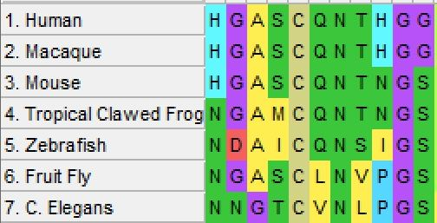
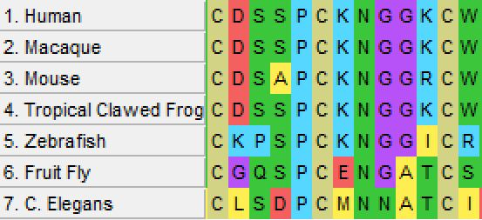
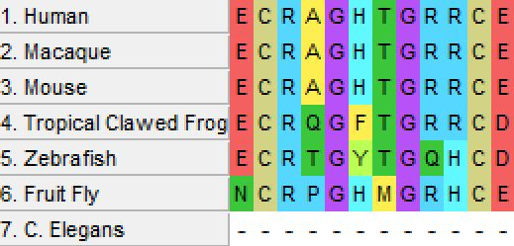
AIM 1: Determine which EGF-like calcium binding domains are necessary for aortic valve calcification
Q484
A929
G1119
R1350
Heart
No heart
14

Slide 15
AIM 1: Determine which EGF-like calcium binding domains are necessary for aortic valve calcification
WT
Q484L
A929R
G1119E
R1350L
15

Slide 16
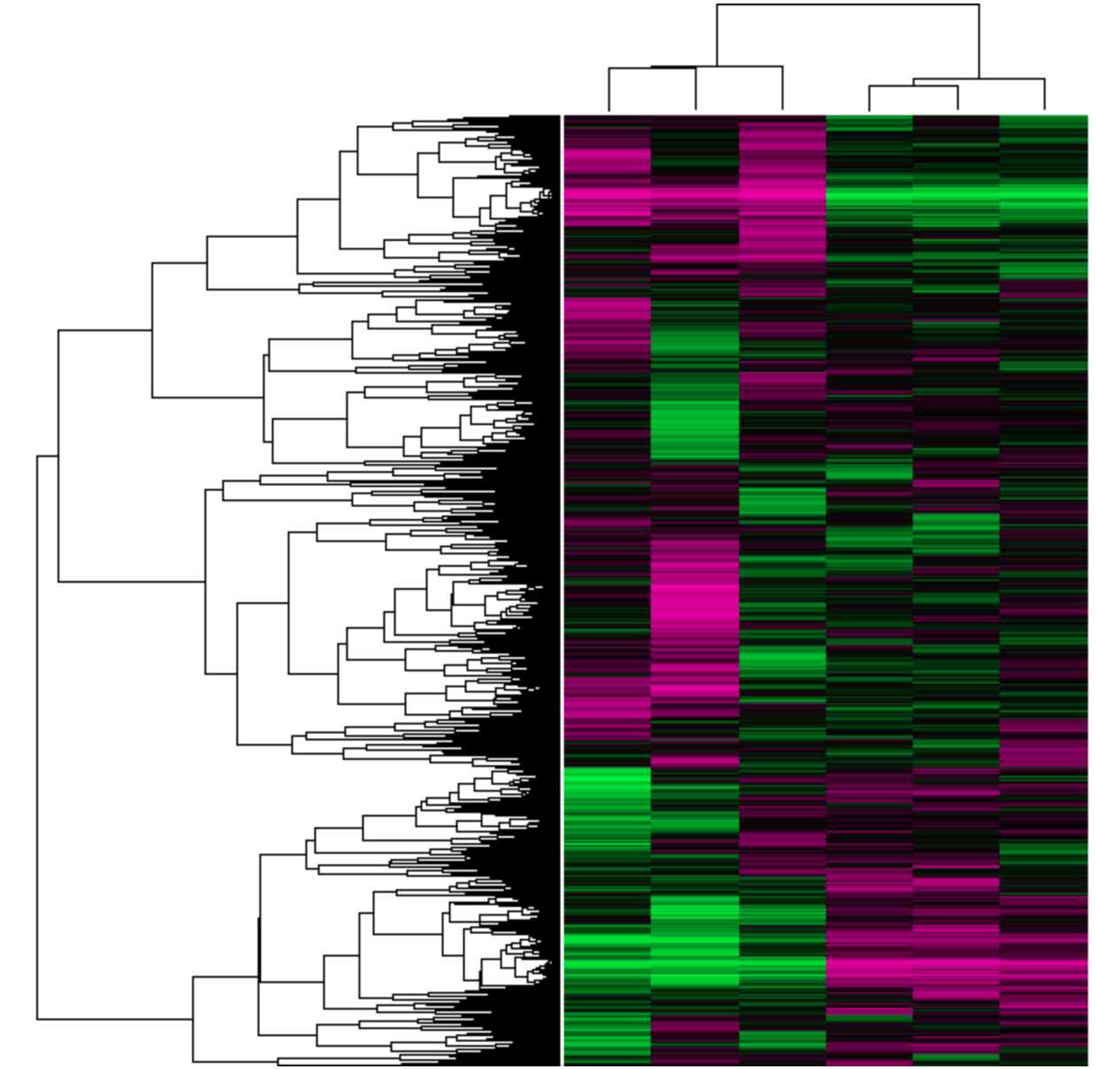
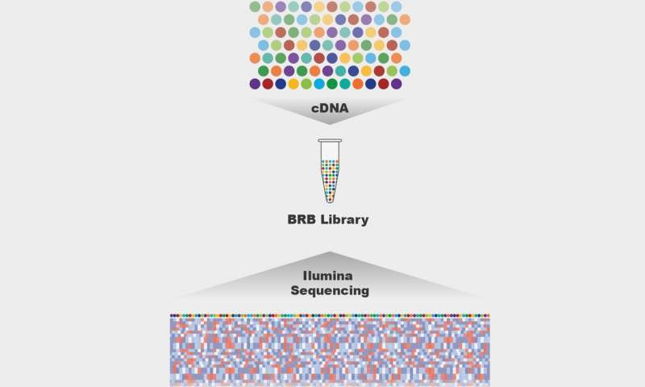
Hypothesis 2: Mutation of conserved NOTCH1 EGF-like calcium binding domains leads to a shift from smooth muscle expression to osteoblast expression
WT
Q484L
A929R
G1119E
R1350L
CRISPR
LIBRARY
RNA-SEQ
GEO
16

Slide 17
AIM 2: Identify which EGF-like calcium binding domain is necessary for proper smooth muscle expression
WT
Mutant
Gene Ontology
NOTCH signaling
Calcium signaling
Angiogenesis
BMP pathway
NOTCH signaling
Osteogenesis
Low
High
17

Slide 18
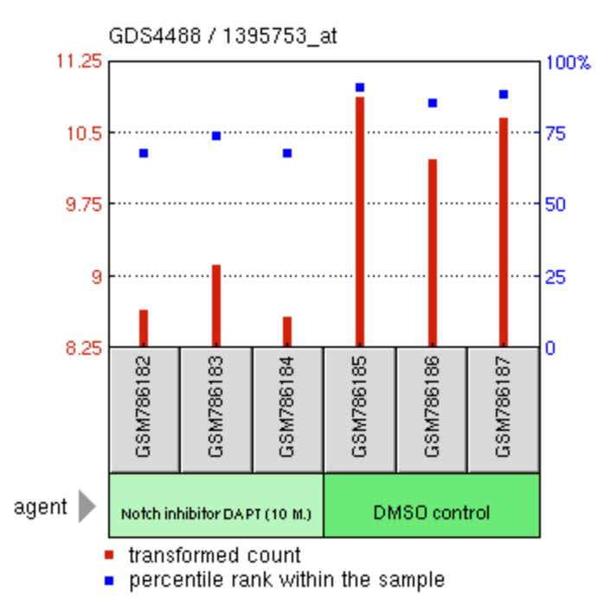
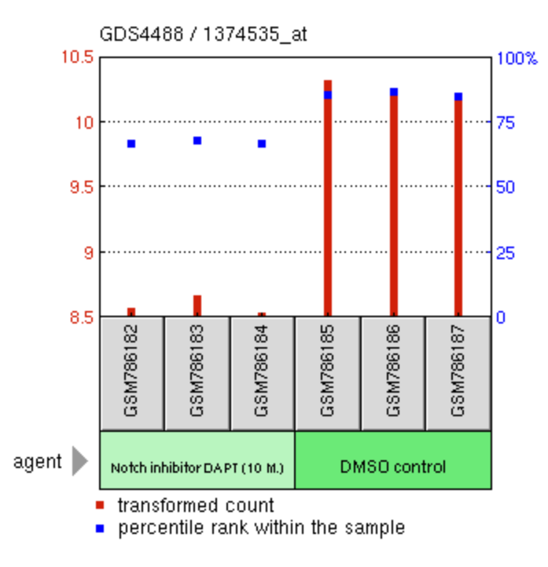
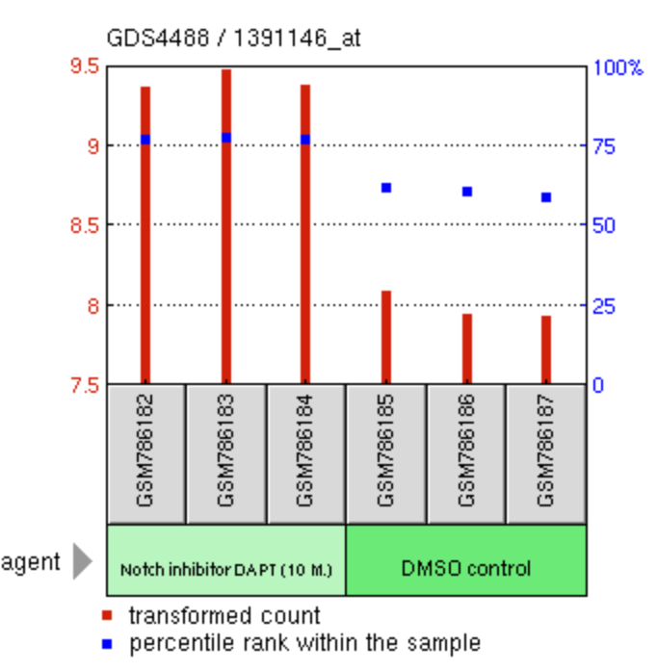
AIM 2: Identify which EGF-like calcium binding domain is necessary for proper smooth muscle expression
ELN
AFAP1L2
CDH11
From “Notch1 signaling inhibition effect on aortic valve interstitial cells” (GDS4488)
18

Slide 19
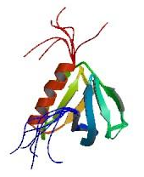
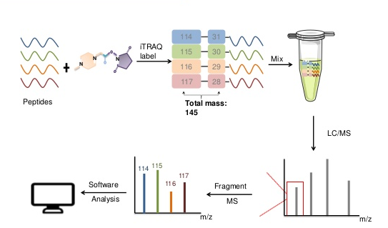
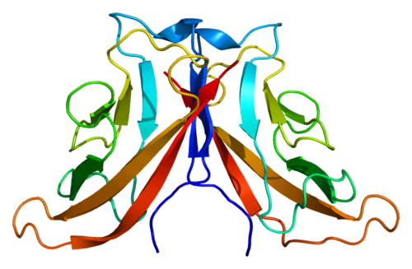
Hypothesis 3: Mutation of conserved NOTCH1 EGF-like calcium binding domains leads to a shift from smooth muscle proteins to osteoblast proteins
WT
Q484L
AFAP1L2
A929R
G1119E
R1350L
CDH11
CRISPR
iTRAQ
LC/MS
19

Slide 20
AIM 3: Determine which EGF-like calcium binding domain crucial for smooth muscle protein expression
Smooth Muscle
Osteoblast
NOTCH1 mutation
Protein Expression
Osteoblast
Smooth Muscle
WT
Q484L
A929R
G1119E
R1350L
20

Slide 21
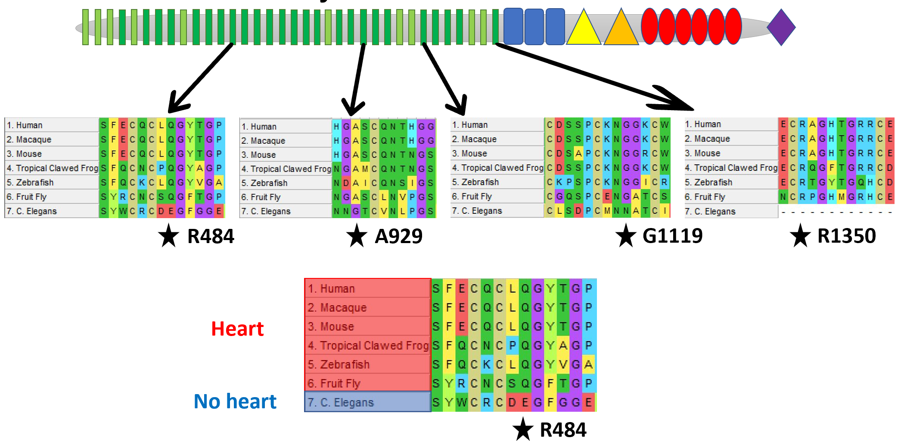
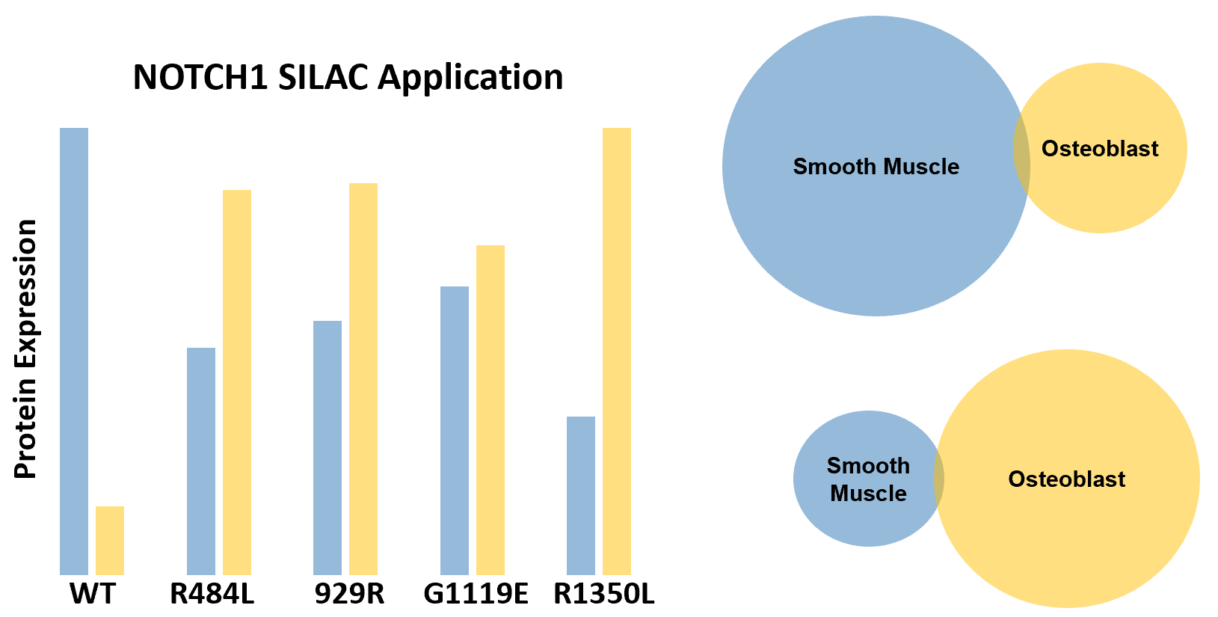
Conclusions
Mutations in NOTCH1 cause Aortic Valve Disease (AoVD1)
Loss in NOTCH1 signaling shifts transcription programming from smooth muscle expression to osteoblast expression
EGF-like like calcium binding domains are highly conserved in animals with complex cardiovascular systems
CRISPR, RNA-seq, and iTRAQ can be utilized to isolate which domains are necessary for proper aortic valve development
21

Slide 22
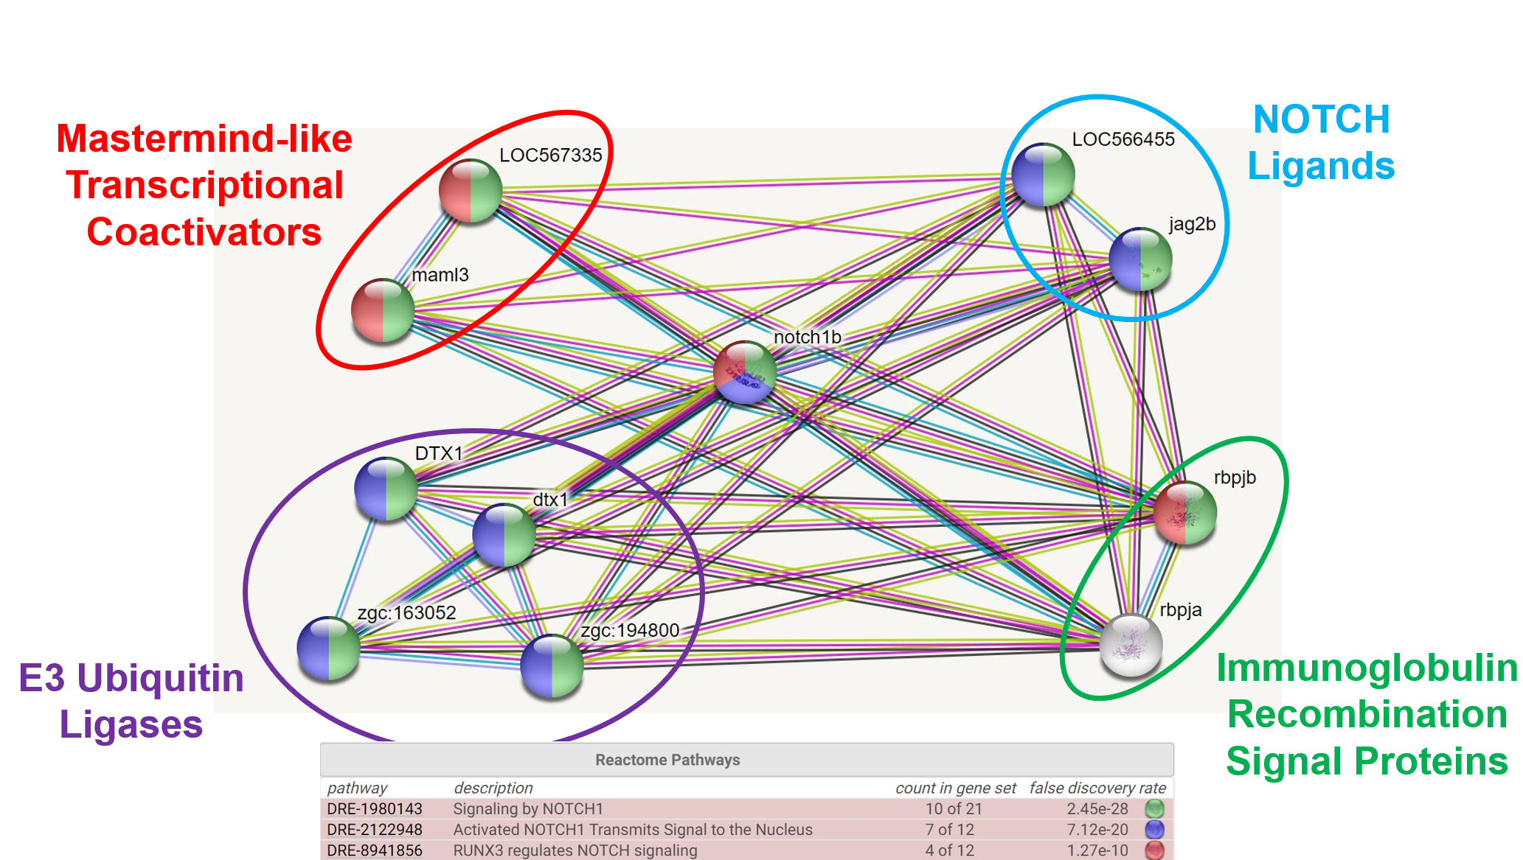
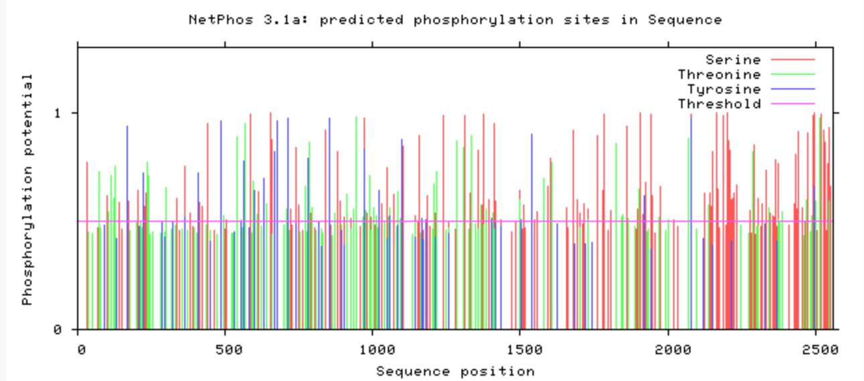
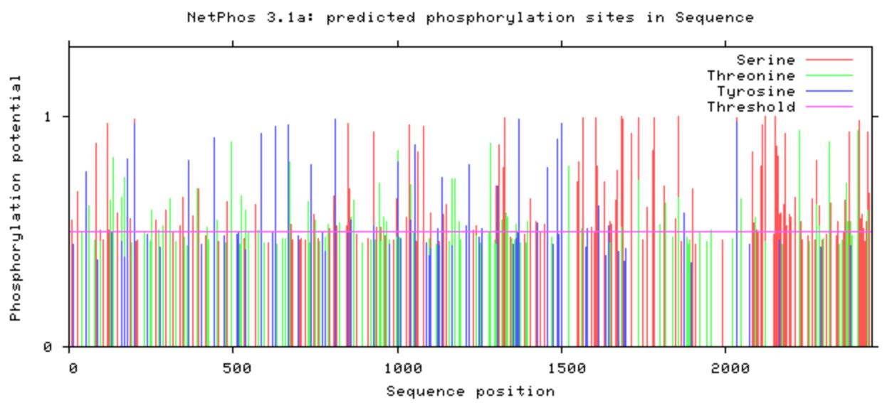
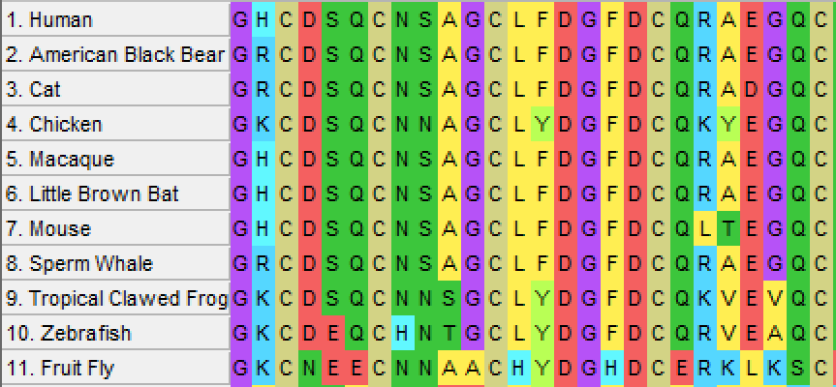
Future Goals
Interactions
PTMs
Motifs
22

Slide 23
Image References:
https://healthblog.uofmhealth.org/Mens-Heart-Disease-Risks-Signs-perfcon
https://genetics.wisc.edu/distinguished-lectures-in-science-daniel-colon-ramos/
https://images.medindia.net/patientinfo/950_400/symptoms-signs-of-bicuspid-aortic-valve.jpg
https://www.balladhealth.org/transcatheter-aortic-valve-replacement-tavr
https://newheartvalve.com/tavr-treatment/about-the-tavr-procedure/
https://www.google.com/search?q=jesse+bertogliat&rlz=1C1EJFC_enUS811US811&source=lnms&tbm=isch&sa=X&ved=2ahUKEwj09c-5j__oAhVTHc0KHQTPB8gQ_AUoAXoECAsQAw&biw=1368&bih=753&dpr=2#imgrc=d1hVSokdboLEjM
https://www.google.com/search?q=julian+bertogliat&rlz=1C1EJFC_enUS811US811&source=lnms&tbm=isch&sa=X&ved=2ahUKEwjOtYDnj__oAhVTQ80KHaSzA3EQ_AUoAnoECAsQBA&biw=1368&bih=753#imgrc=s-xac8mMZX5EbM
http://www.mun.ca/biology/desmid/brian/BIOL2060/BIOL2060-14/CB14old.html
Cohen ED(1), Tian Y, Morrisey EE. Wnt signaling: an essential regulator of cardiovascular differentiation, morphogenesis and progenitor self-renewal. Development. 2008 Mar;135(5):789-98. doi: 10.1242/dev.016865.
Hao X, Tian J, Yin L, et al. (2017). MRI detects protective effects of DAPT treatment with modulation of microglia/macrophages at subacute and chronic stages following cerebral ischemia. Molecular Medicine Reports. 16. 10.3892/mmr.2017.7200.
https://image.freepik.com/freie-ikonen/bar-seitenansicht-silhouette_318-42619.jpg
https://image.flaticon.com/icons/svg/47/47197.svg
http://imageog.flaticon.com/icons/png/512/47/47096.png?size=1200x630f&pad=10,10,10,10&ext=png&bg=FFFFFFFF
https://photos.gograph.com/thumbs/CSP/CSP418/bat-silhouette-stock-illustration_k19082699.jpg
http://imageog.flaticon.com/icons/png/512/47/47240.png?size=1200x630f&pad=10,10,10,10&ext=png&bg=FFFFFFFF
https://upload.wikimedia.org/wikipedia/commons/thumb/d/d8/Person_icon_BLACK-01.svg/721px-Person_icon_BLACK-01.svg.png
https://image.freepik.com/free-icon/monkey_318-62892.png
https://image.freepik.com/free-icon/chicken-symbol_318-10389.jpg
23

Slide 24
Image References:
19. https://image.shutterstock.com/image-photo/image-450w-59417659.jpg
20. https://media.istockphoto.com/vectors/vector-set-of-black-aquarium-fish-silhouettes-with-text-vector-id1145856310?k=6&m=1145856310&s=612x612&w=0&h=gOnb4kwuztGEmfrxQpe4RoNNW3OkwoTyLOnIHelnWYE=
21. https://d30y9cdsu7xlg0.cloudfront.net/png/40840-200.png
22. https://imageog.flaticon.com/icons/png/512/47/47217.png?size=1200x630f&pad=10,10,10,10&ext=png&bg=FFFFFFFF
23. van Opbergen C, van der Voorn S, et al. Cardiac Ca²⁺ signalling in zebrafish: Translation of findings to man. Prog Biophys Mol Biol. 2018 Oct;138:45-58. doi: 10.1016/j.pbiomolbio.2018.05.002
24. Li M, Hu X, et al. Overexpression of miR-19b Impairs Cardiac Development in Zebrafish by Targeting ctnnb1. Cell Physiol Biochem 2014;33:1988-2002; https://doi.org/10.1159/000362975
25. Lee YM, Cope JJ, Ackermann GE, et al. Vascular endothelial growth factor receptor signaling is required for cardiac valve formation in zebrafish. Dev Dyn. 2006;235(1):29–37. doi:10.1002/dvdy.20559
26. Ribeiro I, Kawakami Y, Büscher D, et al. Tbx2 and Tbx3 regulate the dynamics of cell proliferation during heart remodeling. PLoS One. 2007;2(4):e398. Published 2007 Apr 25. doi:10.1371/journal.pone.0000398
27. Camarata T, Krcmery J, et al. Pdlim7 (LMP4) regulation of Tbx5 specifies zebrafish heart atrio-ventricular boundary and valve formation. Dev Biol. 2010;337(2):233–245. doi:10.1016/j.ydbio.2009.10.039
28. https://www.genome.gov/sites/default/files/tg/en/illustration/zebrafish.jpg
29. https://www.mirusbio.com/assets/figures/crispr-rnp-delivery-approach.png
30. https://www.the-scientist.com/news-opinion/rnais-future-in-drug-target-screening-31651
31. https://phys.org/news/2019-04-brb-seq-quick-cheaper-future-rna.html
32. Acharya A, Hans C, Koenig S, et al. Inhibitory role of Notch1 in calcific aortic valve disease. PLoS One. 2011;6(11):e27743. doi:10.1371/journal.pone.0027743
33. https://www.slideshare.net/Creative-Proteomics/mass-spectrometrybased-proteomics-quantification-itraq
34. https://www.phosphosite.org/proteinAction?id=4755&showAllSites=true
35. https://en.wikipedia.org/wiki/CDH11
23

