Slide 1
The role of NOTCH1 in Aortic Valve Disease (AoVD1)
Mario Bertogliat
Gen 564

Slide 2
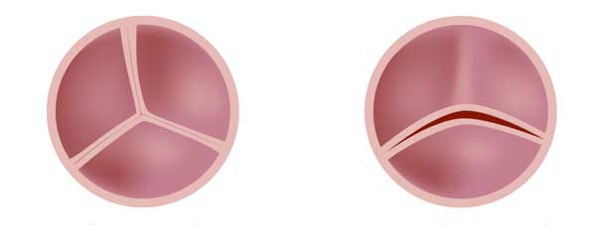
What is Aortic Valve Disease 1 (AoVD1)?
Bicuspid Malformation
Regurgitation
Stenosis
1

Slide 3
How does AoVD1 manifest?
2

Slide 4
NOTCH1 is associated with AoVD1
EGF and EGF CA
NL
NOD
NODP
ANK
DUF
Ligand Binding Regulation/Dimerization Signal Transduction
Molecular function
Biological process
Cellular component
Calcium ion binding
Chromatin DNA binding
RNA polymerase II-specific activity
Organ regeneration
Valve morphogenesis
Apoptotic embryonic digit morphogenesis
Cell membrane
Nucleus
3

Slide 5
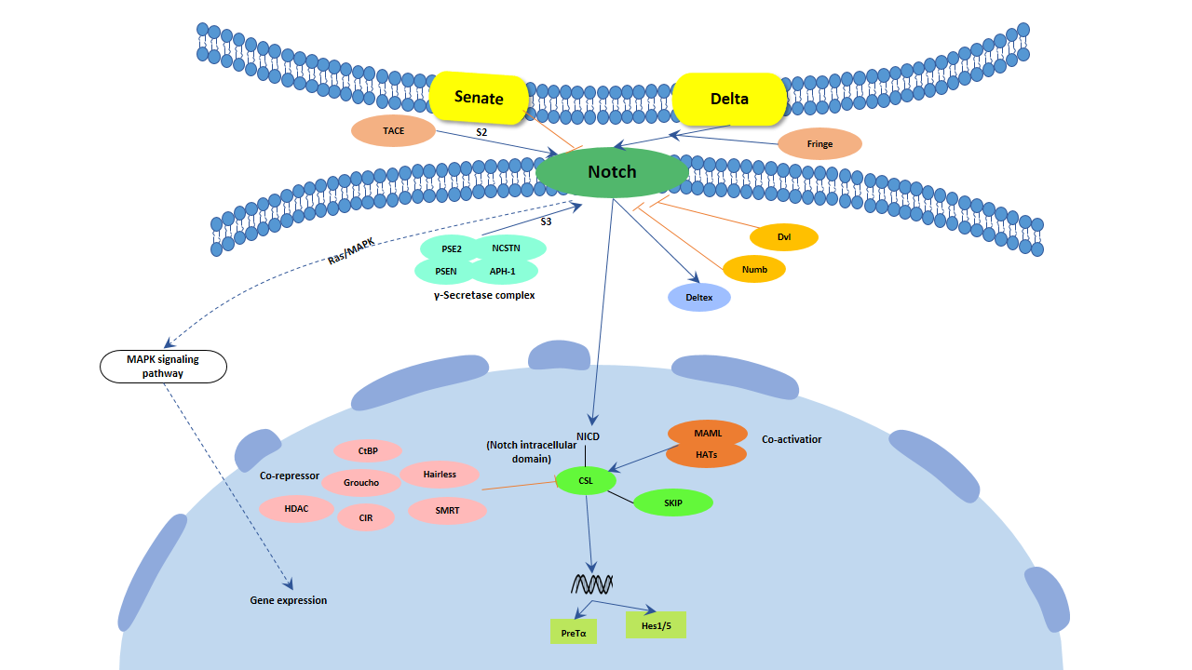
The NOTCH Signaling Pathway
4

Slide 6
NOTCH1 is a conserved transmembrane receptor
2555 AA -%
EGF and EGF CA
NL
NOD
NODP
ANK
DUF
Human
2531 AA 90.73%
Mouse
2436 AA 67.03%
Zebrafish
2703 AA 49.37%
Fruit Fly
1429 AA 27.67%
C. Elegans
5

Slide 7
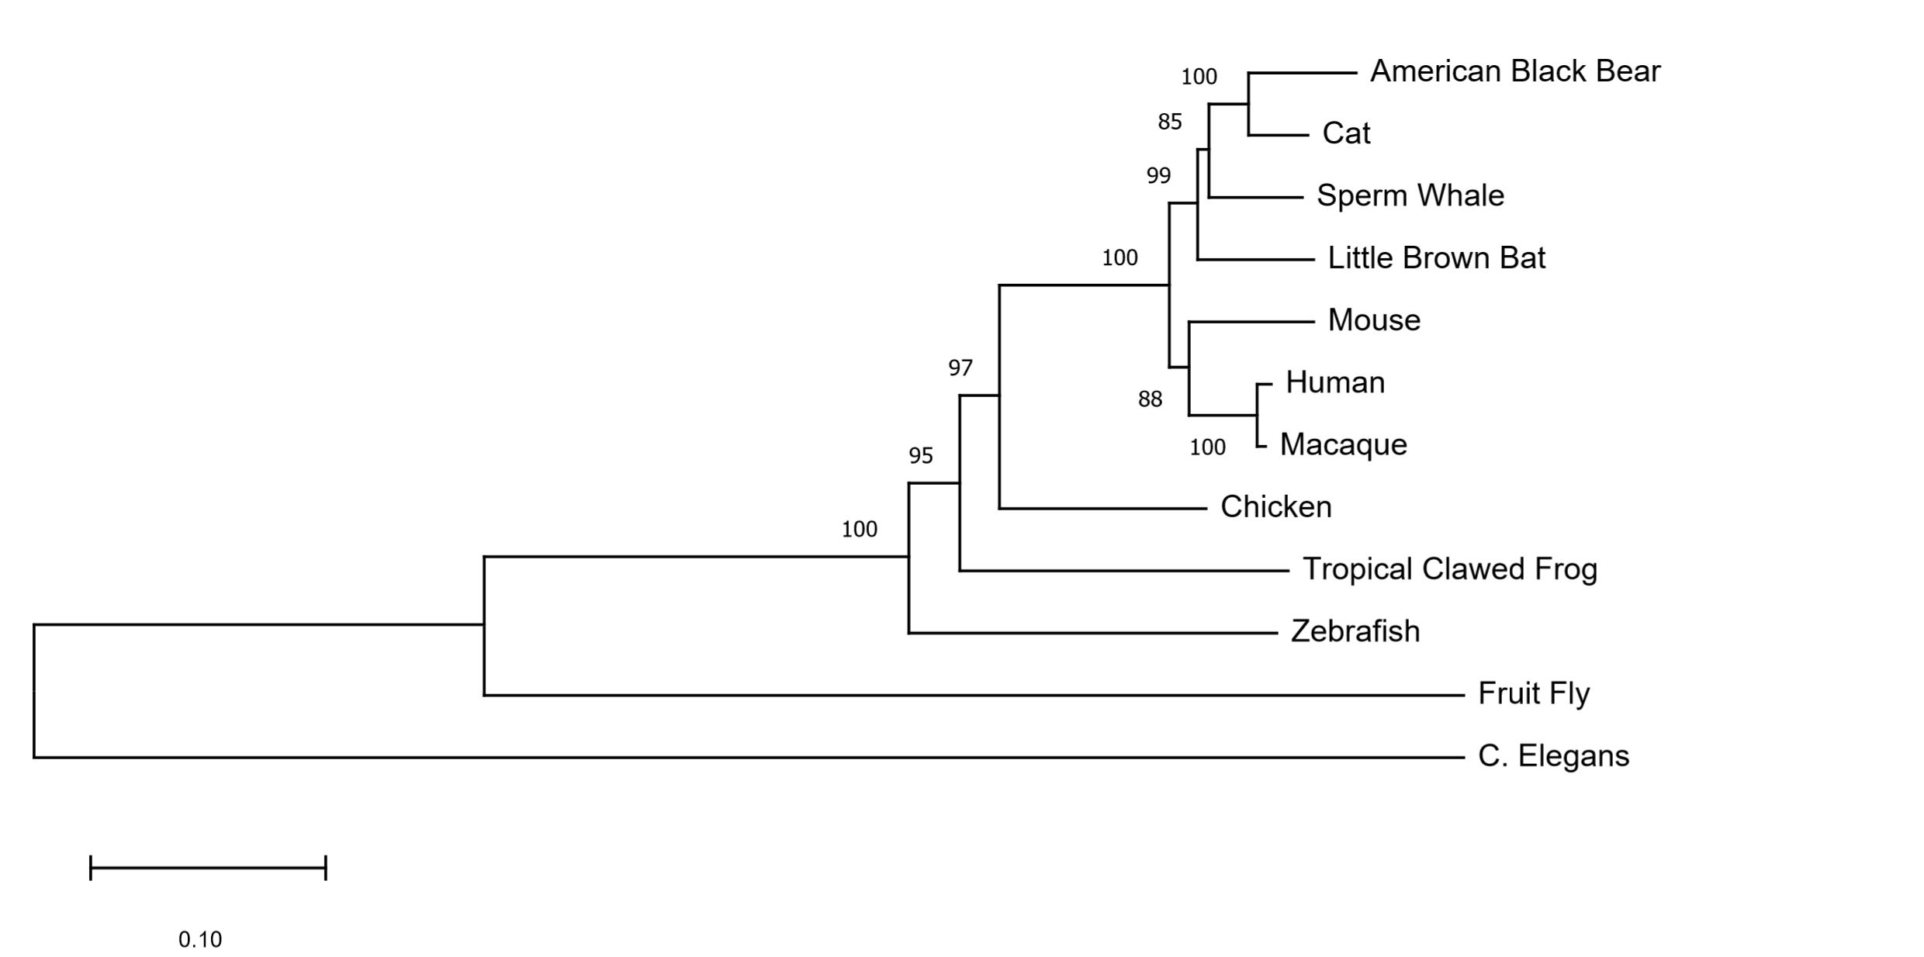
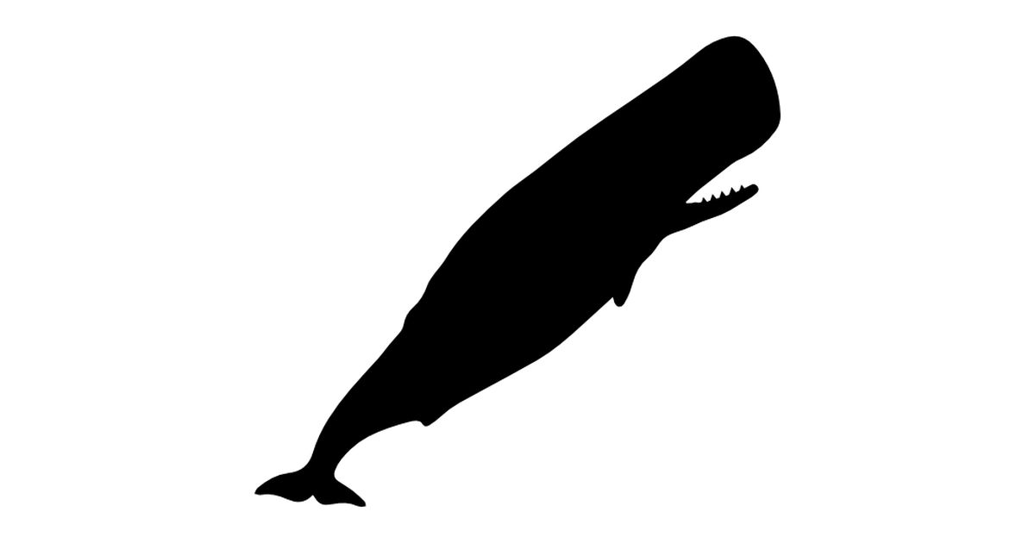
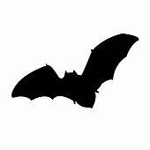
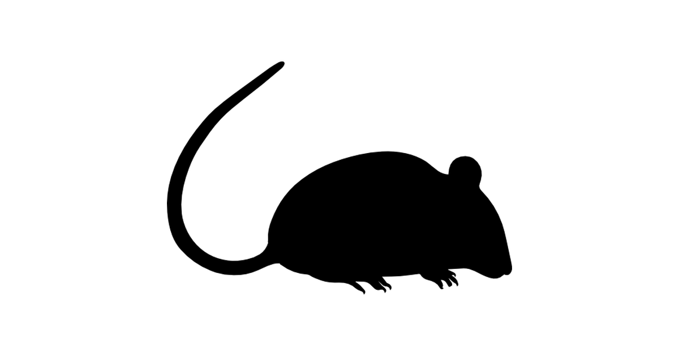
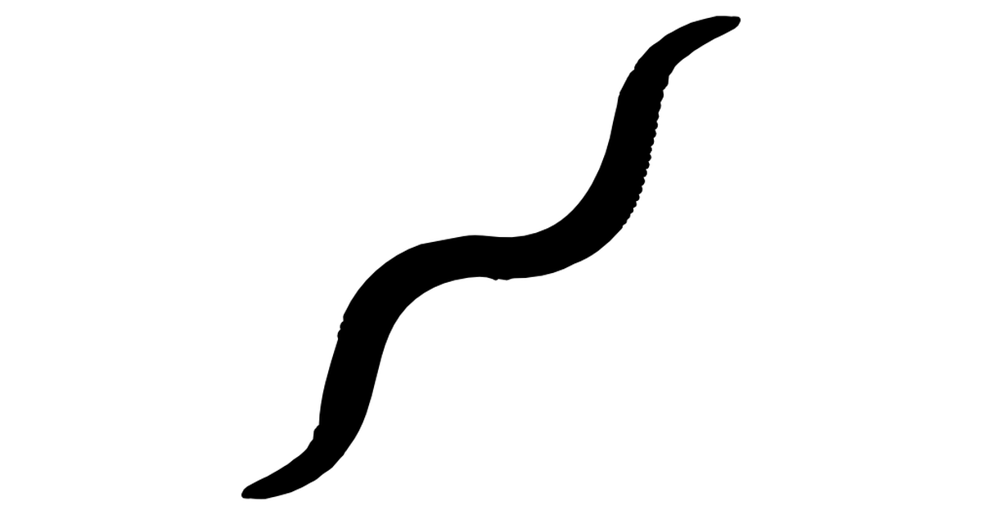
NOTCH1 is well conserved among vertebrates
Muscle aligned neighbor-joining method
6

Slide 8
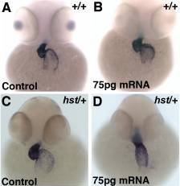
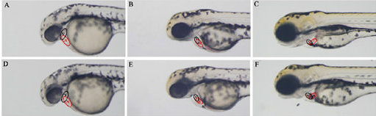
Zebrafish can be used to study heart development
7

Slide 9
What is the gap in knowledge?
How do mutations within the same gene lead to three drastically different phenotypes in the aortic valve?
8

Slide 10
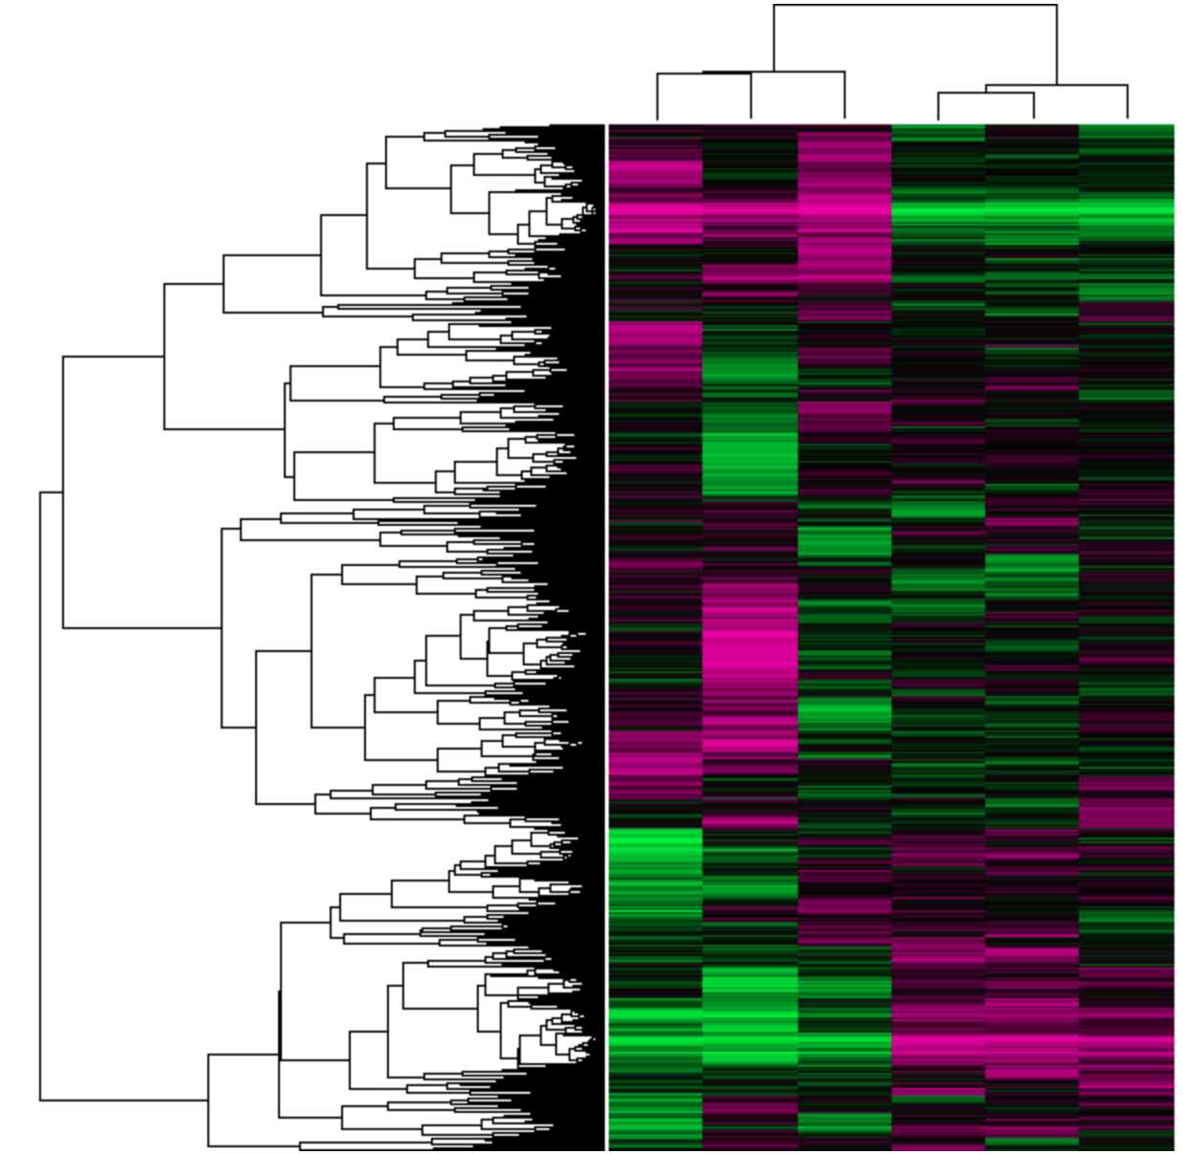
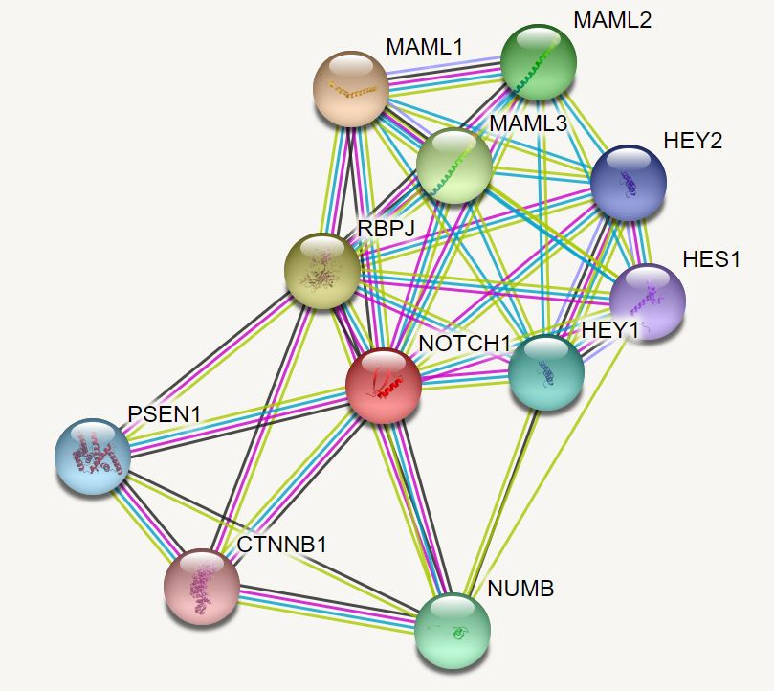
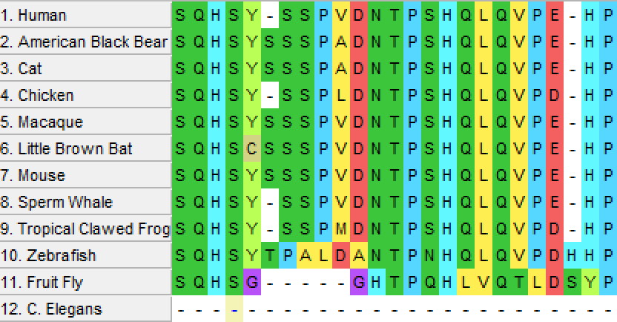
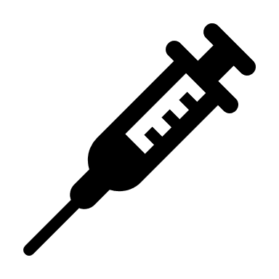
What is my primary goal?
Determine the role of NOTCH1 in aortic valve formation
AIM 1
AIM 2
AIM 3
Identify and mutate conserved amino acids in NOTCH1
Identify expression changes in response to NOTCH1 knockdown
Compare protein interactions of WT and mutant NOTCH1 lines
9

Slide 11
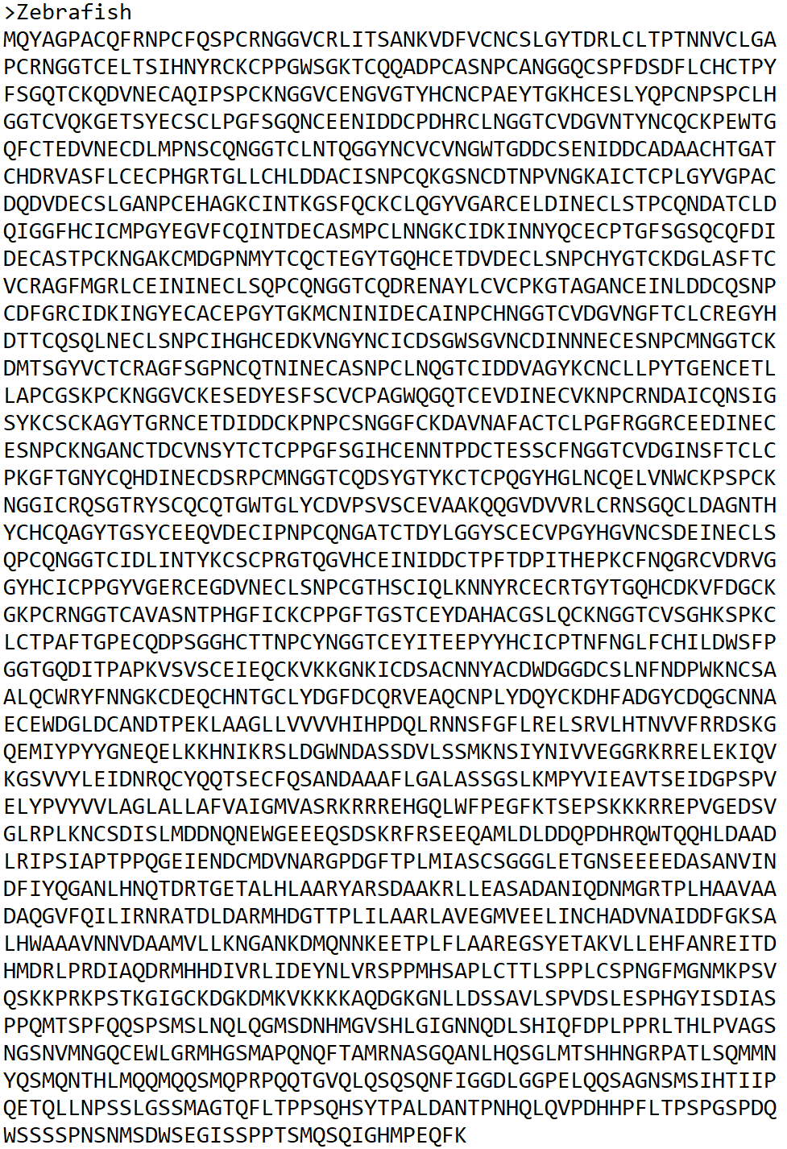
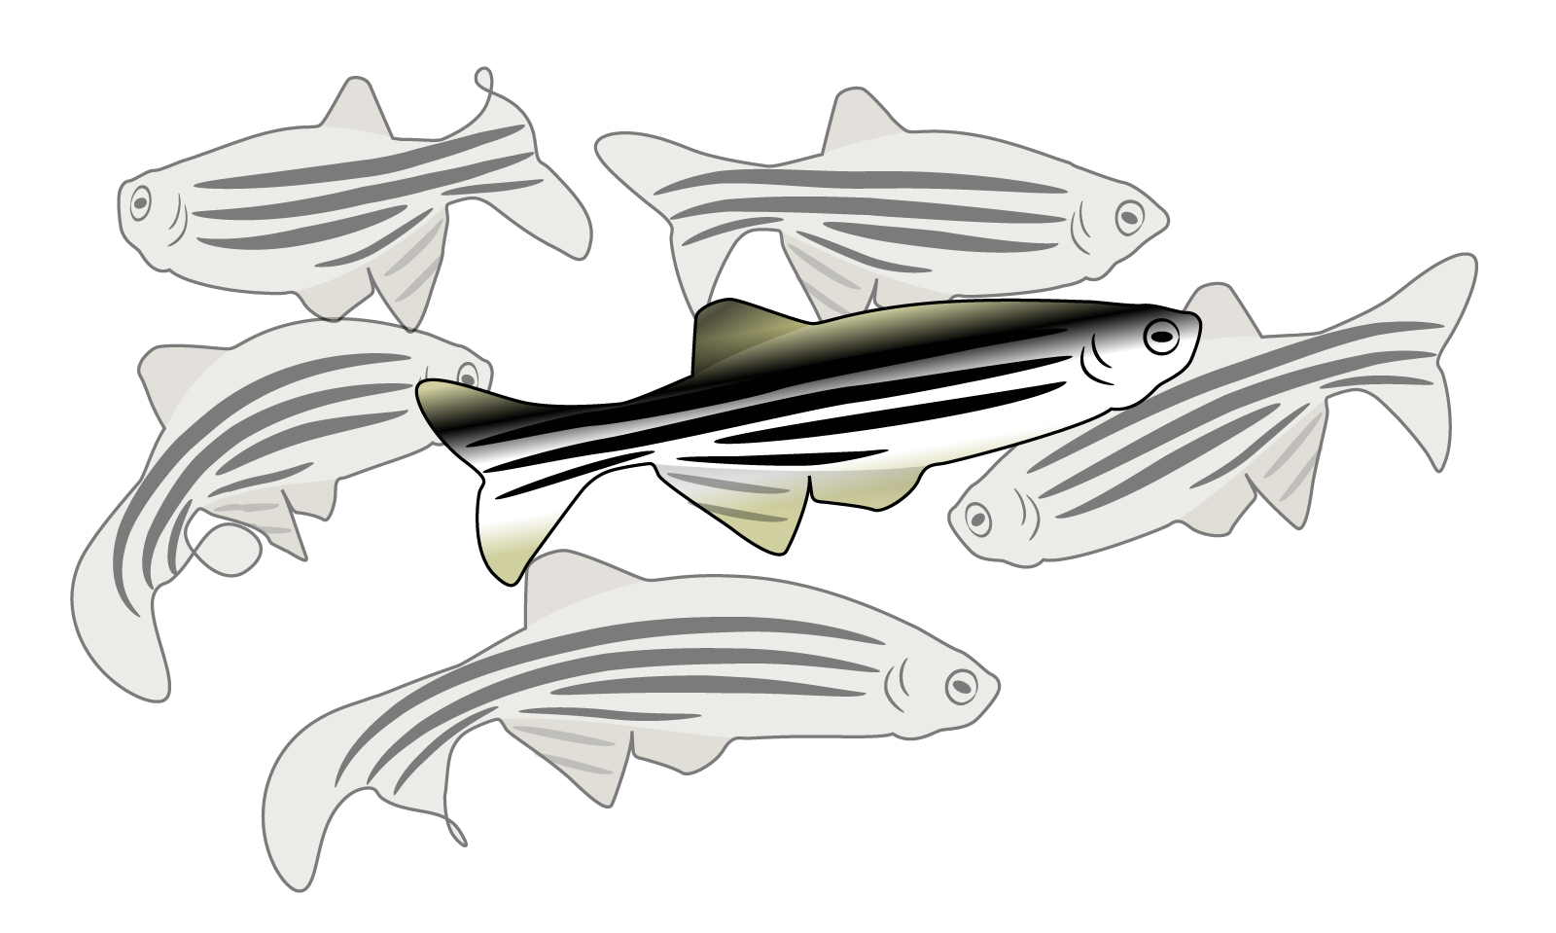
Hypothesis 1: Conserved NOTCH1 residues are critical to aortic valve development
FASTA
MEGA
CRISPR
SCREEN
10

Slide 12
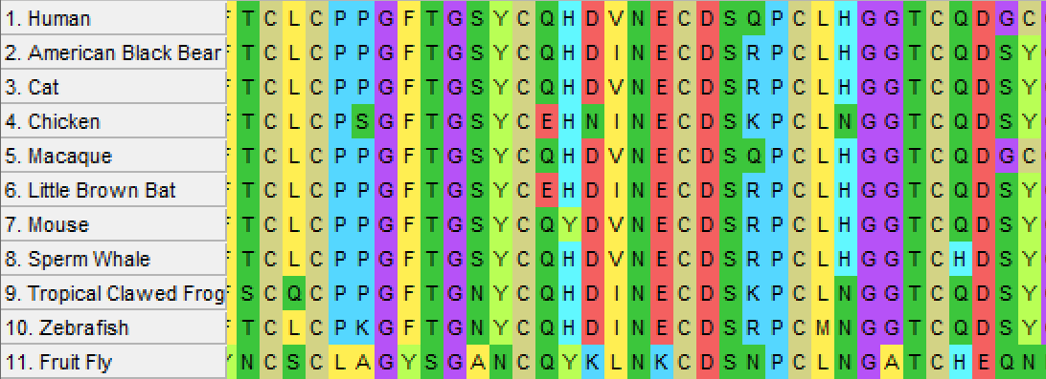
AIM 1: Identify and mutate conserved NOTCH1 amino acids
Clustal Alignment Site 1071-1105
Possible Cysteine-Glycine Motif
11

Slide 13
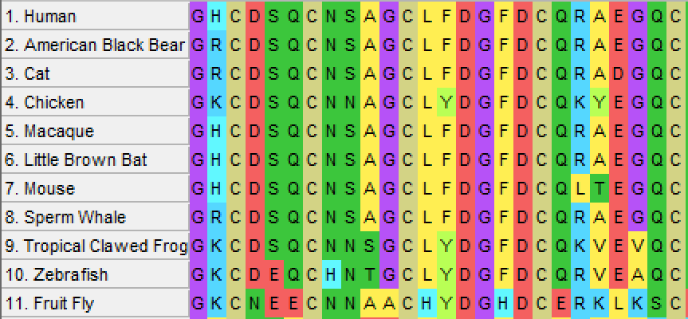
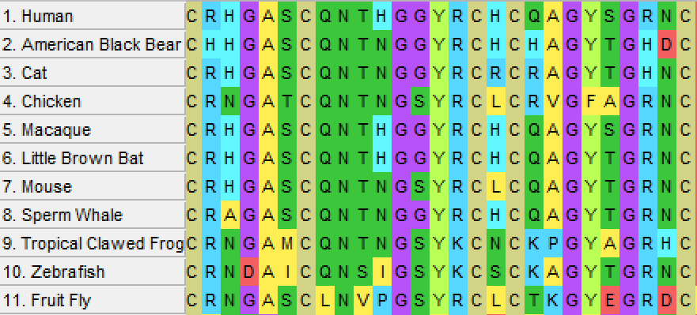
AIM 1: Identify and mutate conserved NOTCH1 amino acids
Clustal Alignment Site 1580-1605
Clustal Alignment Site 942-968
Top 3 NOTCH1 motifs
12

Slide 14
AIM 1: Identify and mutate conserved NOTCH1 amino acids
WT
C942A
G953T
C1072A
G1580T
13

Slide 15
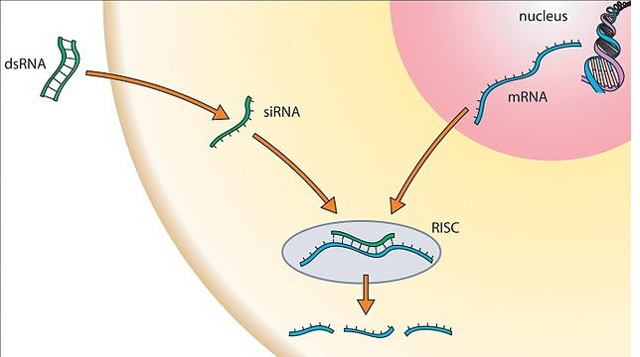
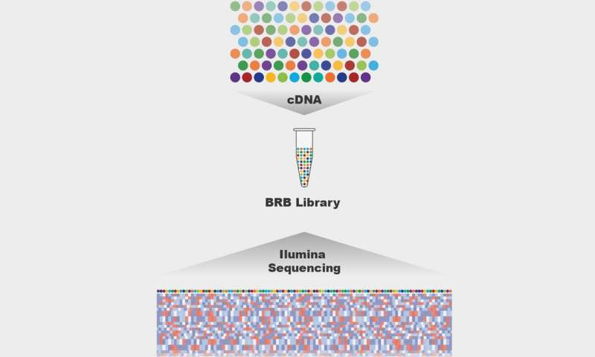
Hypothesis 2: Genes related to aortic valve development will be dysregulated with knockdown of NOTCH1
RNAi
LIBRARY
RNA-SEQ
GEO
14

Slide 16
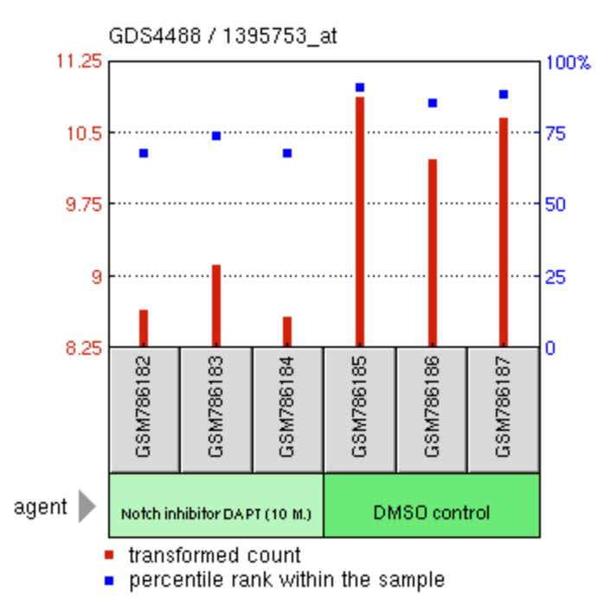
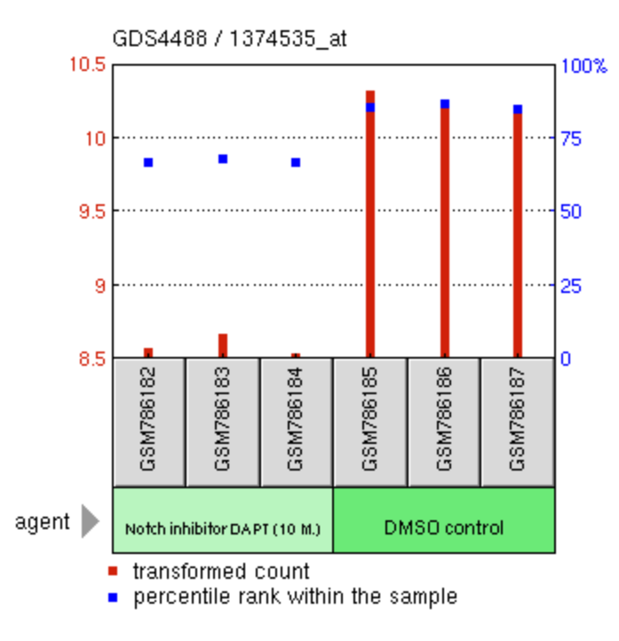
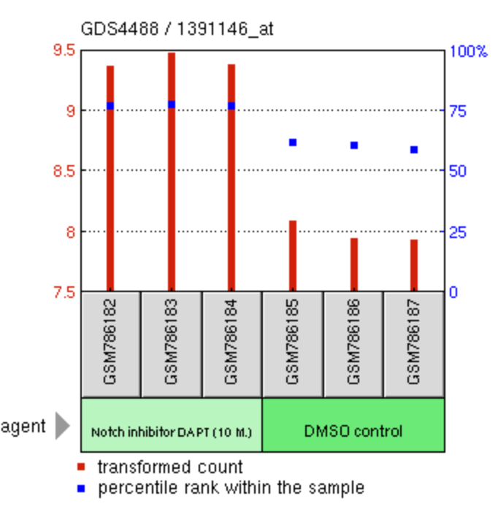
AIM 2: Identify genes aberrantly expressed upon NOTCH1 knockdown and their function
Actin filament associated protein 1 like 2 (AFAP1L2)
Elastin (ELN)
Cadherin 11 (CDH11)
From “Notch1 signaling inhibition effect on aortic valve interstitial cells” (GDS4488)
15

Slide 17
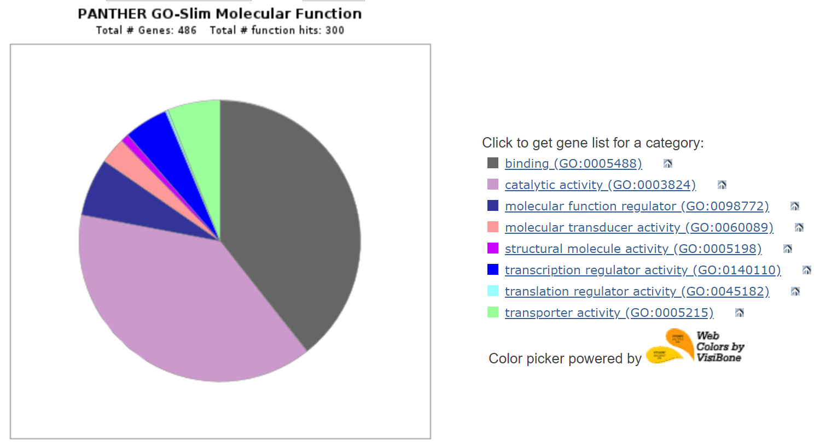
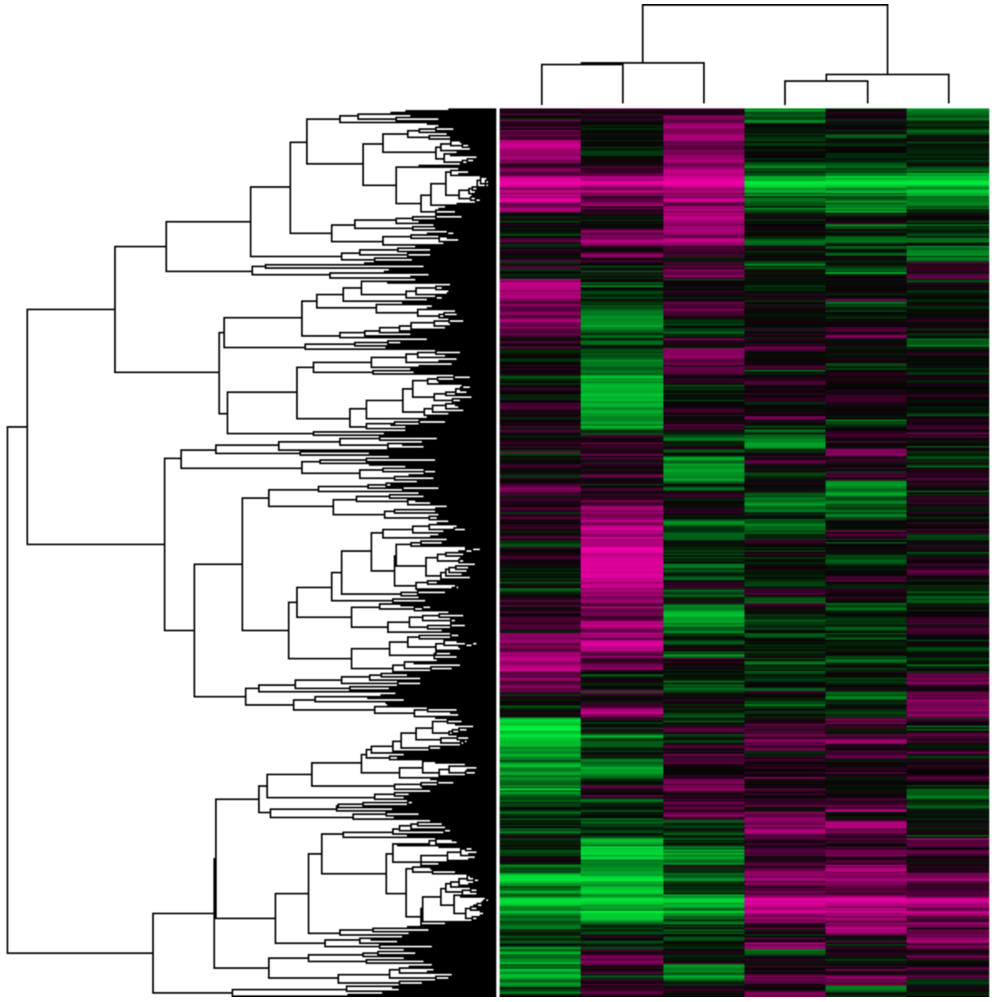
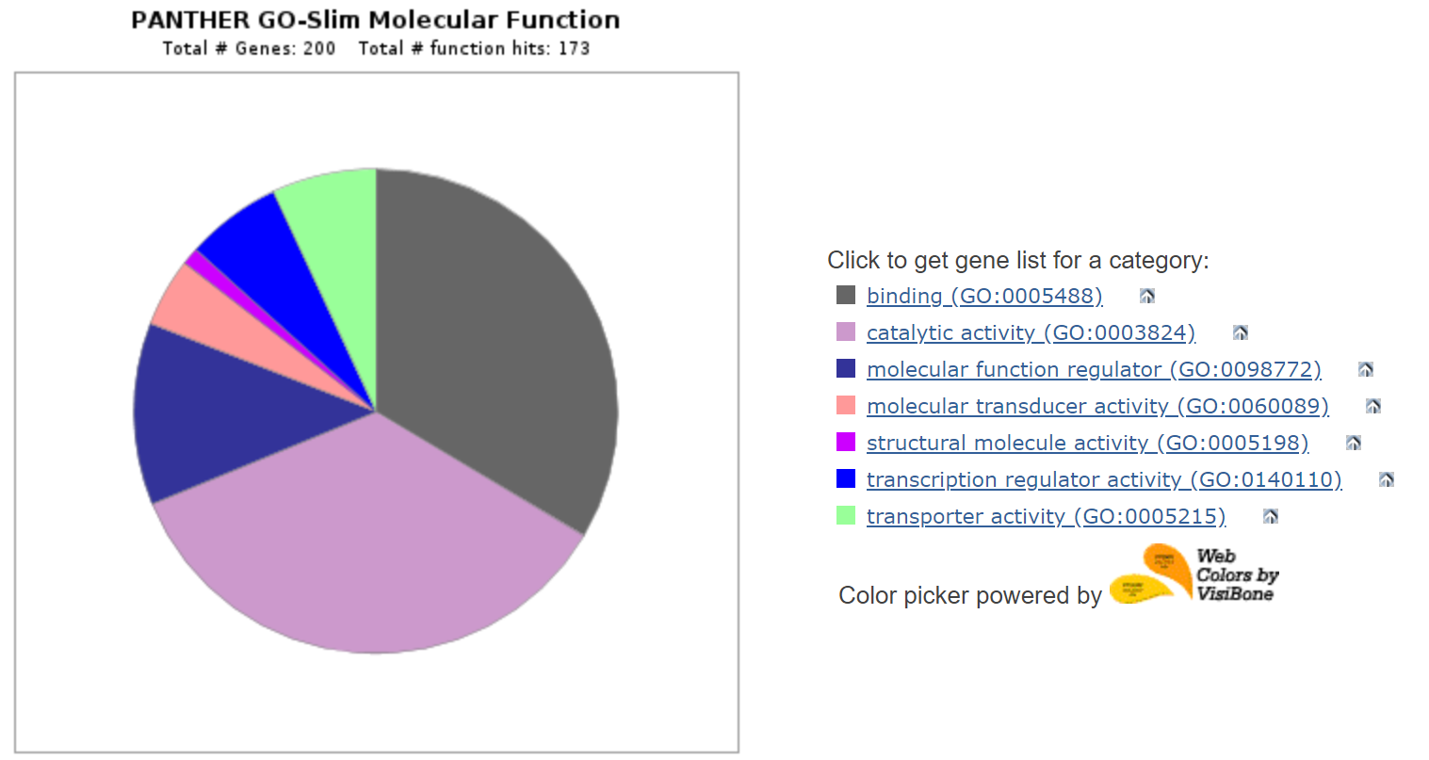
AIM 2: Identify genes aberrantly expressed upon NOTCH1 knockdown and their function
DMSO
KD
Pink = Upregulated Green = Downregulated
16

Slide 18
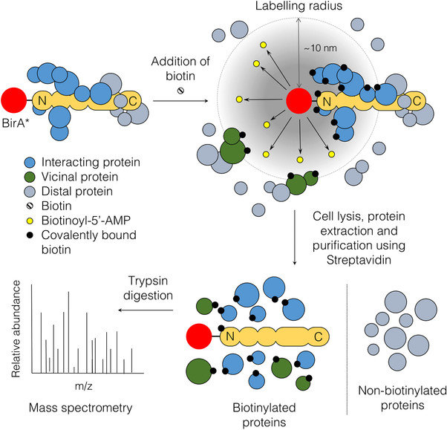
Hypothesis 3: NOTCH1 mutation leads to impaired interaction of proteins critical to aortic valve formation
WT
C942A
G953T
C1072A
G1580T
CRISPR
BioID
LC/MS
STRING
17

Slide 19
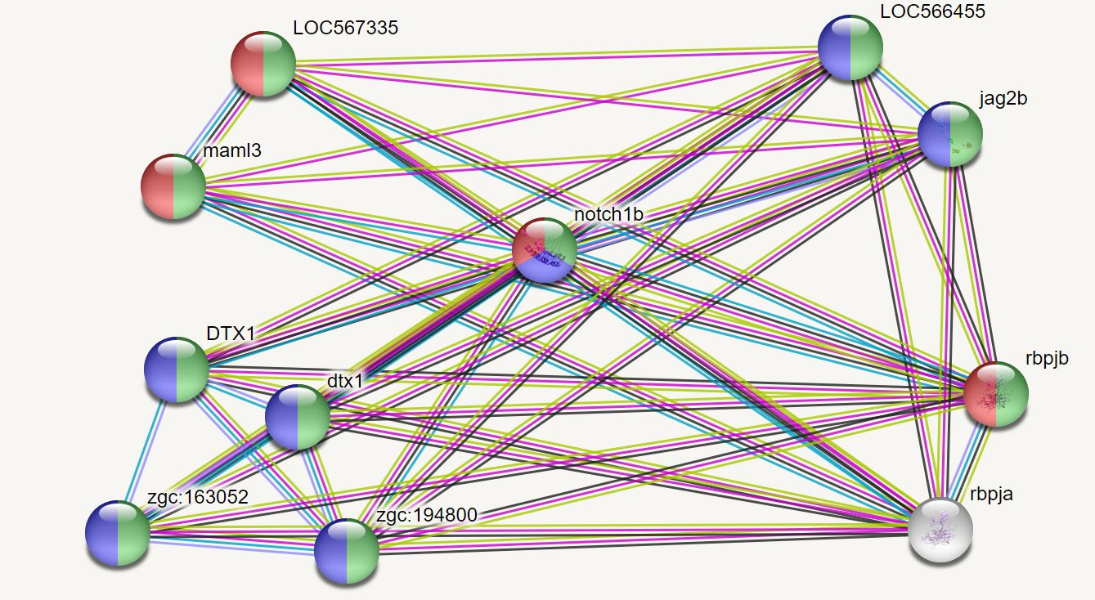
AIM 3: Compare protein interactions of WT and mutant NOTCH1 lines
NOTCH Ligands
Mastermind-like Transcriptional Coactivators
E3 Ubiquitin Ligases
Immunoglobulin Recombination Signal Proteins
18

Slide 20
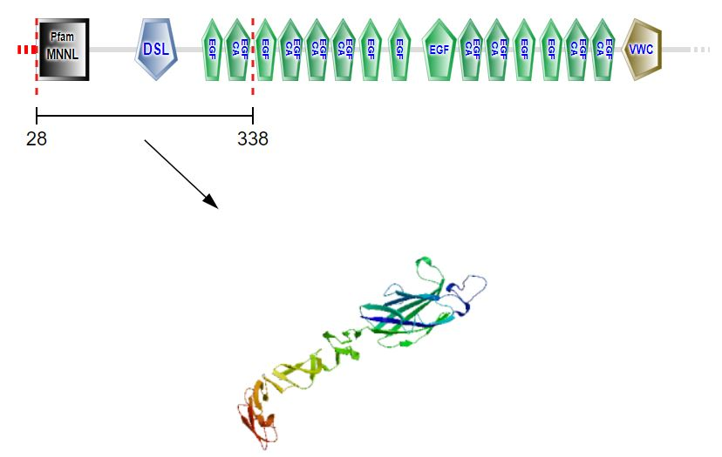
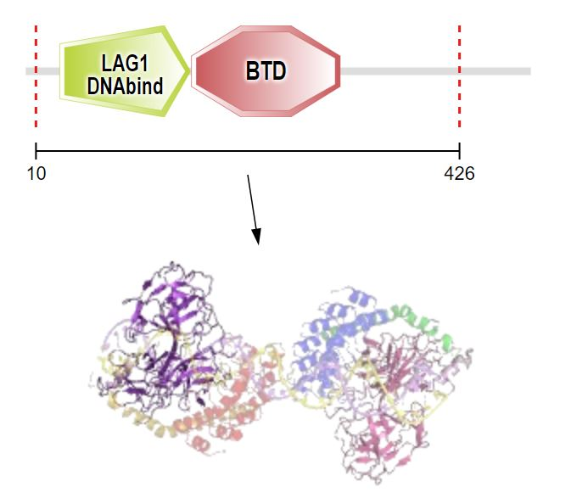
AIM 3: Compare protein interactions of WT and mutant NOTCH1 lines
Mastermind-like Transcriptional Coactivators
E3 Ubiquitin Ligases
Dtx
Dtx1
Zgc 162053
Zgc 194800
Loc567335
Maml3
NOTCH Ligands
Loc566455
Jag2b
Immunoglobulin Recombination Signal Proteins
Rbpja
Rbpjb
19

Slide 21
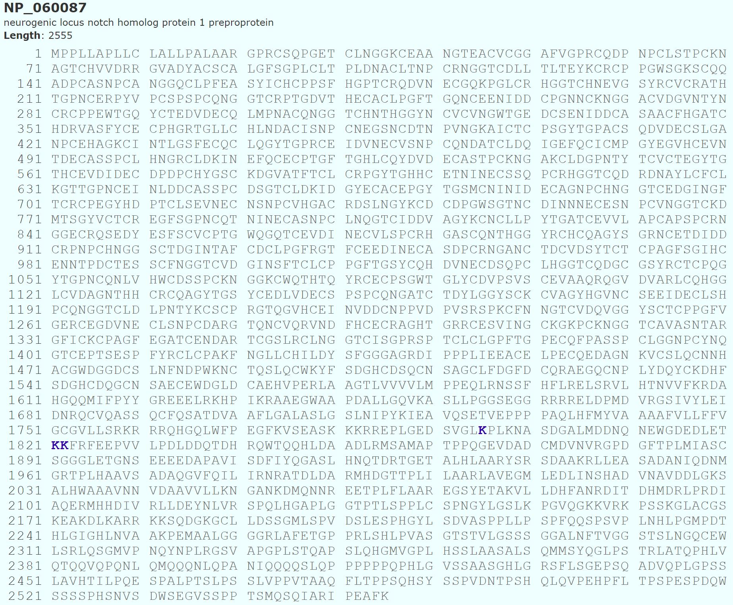
AIM 3: Compare protein interactions of WT and mutant NOTCH1 lines
Human ubiquitination sites (K1795, 1821, and 1822)
20

Slide 22
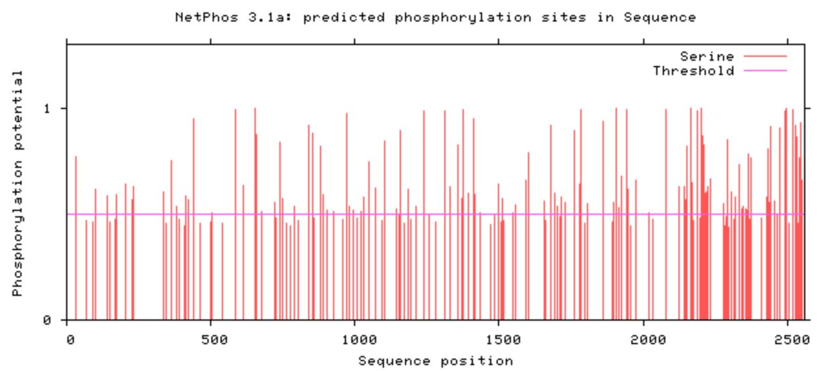
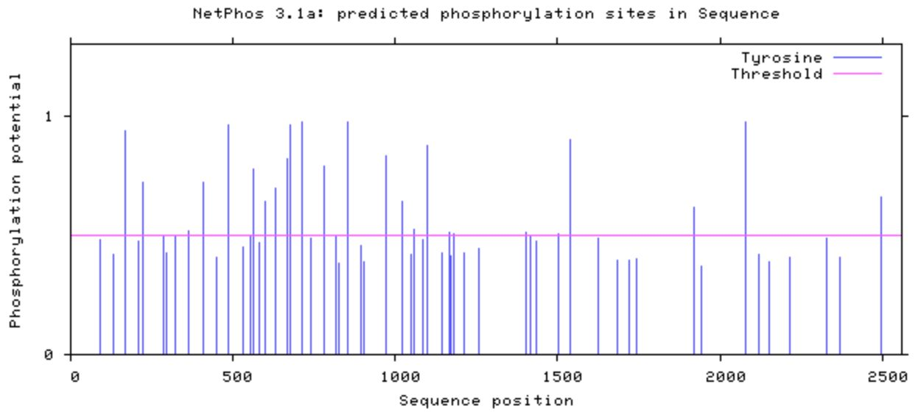
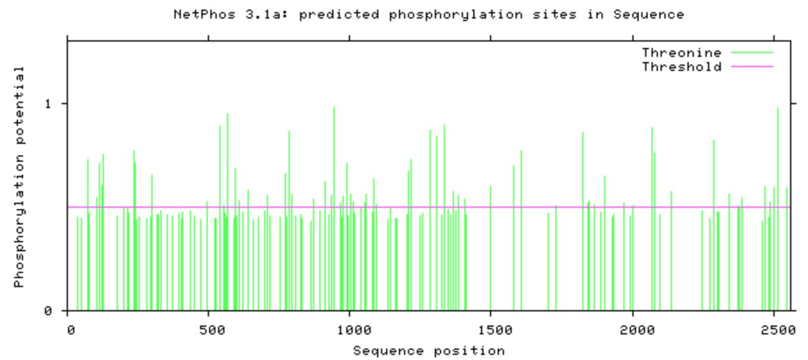
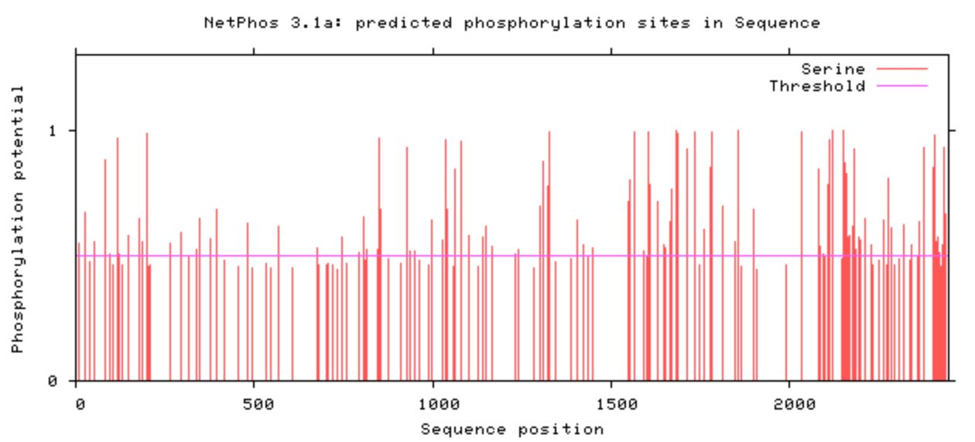
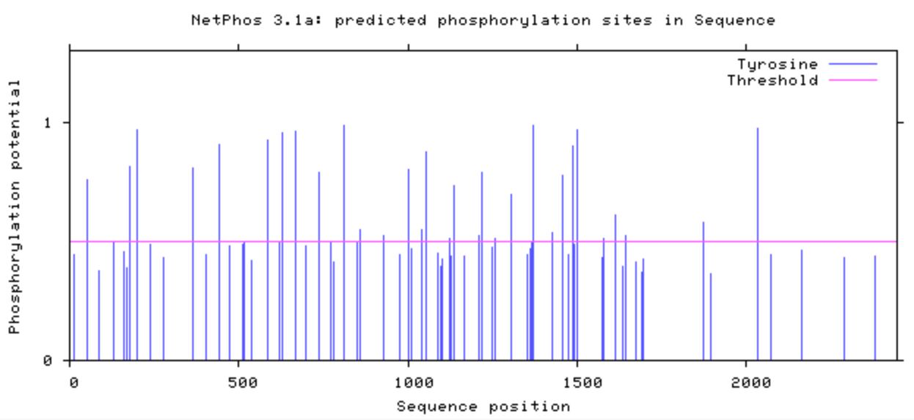
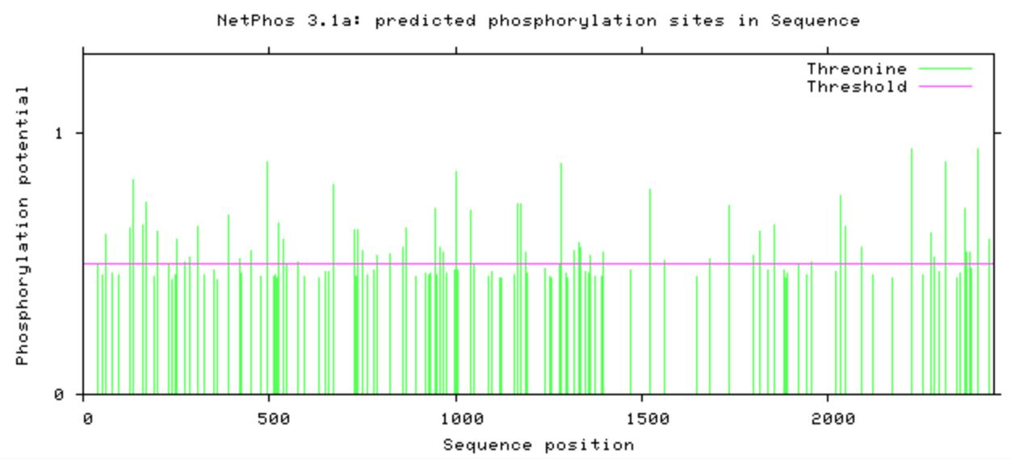
AIM 3: Compare protein interactions of WT and mutant NOTCH1 lines
Human Serine Phosphorylation Sites
Human tyrosine phosphorylation sites
Human threonine phosphorylation sites
Zebrafish Serine Phosphorylation Sites
Zebrafish tyrosine phosphorylation sites
Zebrafish threonine phosphorylation sites
21

Slide 23
Image References:
https://healthblog.uofmhealth.org/Mens-Heart-Disease-Risks-Signs-perfcon
https://genetics.wisc.edu/distinguished-lectures-in-science-daniel-colon-ramos/
https://www.mayoclinic.org/diseases-conditions/aortic-valve-disease/symptoms-causes/syc-20355117
https://www.heart-valve-surgery.com/Images/bicuspid-aortic-valve-comparison.jpg
https://www.johnmuirhealth.com/content/dam/jmh/Dept-Specific/cardiac-services/as_hearts.jpg
https://images.medindia.net/patientinfo/950_400/symptoms-signs-of-bicuspid-aortic-valve.jpg
https://image.freepik.com/freie-ikonen/bar-seitenansicht-silhouette_318-42619.jpg
https://image.flaticon.com/icons/svg/47/47197.svg
http://imageog.flaticon.com/icons/png/512/47/47096.png?size=1200x630f&pad=10,10,10,10&ext=png&bg=FFFFFFFF
https://photos.gograph.com/thumbs/CSP/CSP418/bat-silhouette-stock-illustration_k19082699.jpg
http://imageog.flaticon.com/icons/png/512/47/47240.png?size=1200x630f&pad=10,10,10,10&ext=png&bg=FFFFFFFF
https://upload.wikimedia.org/wikipedia/commons/thumb/d/d8/Person_icon_BLACK-01.svg/721px-Person_icon_BLACK-01.svg.png
https://image.freepik.com/free-icon/monkey_318-62892.png
https://image.freepik.com/free-icon/chicken-symbol_318-10389.jpg
https://image.shutterstock.com/image-photo/image-450w-59417659.jpg
https://media.istockphoto.com/vectors/vector-set-of-black-aquarium-fish-silhouettes-with-text-vector-id1145856310?k=6&m=1145856310&s=612x612&w=0&h=gOnb4kwuztGEmfrxQpe4RoNNW3OkwoTyLOnIHelnWYE=
https://d30y9cdsu7xlg0.cloudfront.net/png/40840-200.png
https://imageog.flaticon.com/icons/png/512/47/47217.png?size=1200x630f&pad=10,10,10,10&ext=png&bg=FFFFFFFF
van Opbergen C, van der Voorn S, et al. Cardiac Ca²⁺ signalling in zebrafish: Translation of findings to man. Prog Biophys Mol Biol. 2018 Oct;138:45-58. doi: 10.1016/j.pbiomolbio.2018.05.002
Li M, Hu X, et al. Overexpression of miR-19b Impairs Cardiac Development in Zebrafish by Targeting ctnnb1. Cell Physiol Biochem 2014;33:1988-2002; https://doi.org/10.1159/000362975
Camarata T, Krcmery J, et al. Pdlim7 (LMP4) regulation of Tbx5 specifies zebrafish heart atrio-ventricular boundary and valve formation. Dev Biol. 2010;337(2):233–245. doi:10.1016/j.ydbio.2009.10.039
Page D, Miossec M, et al. Deleterious genetic variants in NOTCH1 are a major contributor to the incidence of non-syndromic Tetralogy of Fallot. bioRxiv 300905; doi: https://doi.org/10.1101/300905
https://www.genome.gov/sites/default/files/tg/en/illustration/zebrafish.jpg
https://www.mirusbio.com/assets/figures/crispr-rnp-delivery-approach.png
https://www.the-scientist.com/news-opinion/rnais-future-in-drug-target-screening-31651
https://phys.org/news/2019-04-brb-seq-quick-cheaper-future-rna.html
Acharya A, Hans C, Koenig S, et al. Inhibitory role of Notch1 in calcific aortic valve disease. PLoS One. 2011;6(11):e27743. doi:10.1371/journal.pone.0027743
Varnaitė R, MacNeill S. Meet the neighbors: Mapping local protein interactomes by proximity-dependent labeling with BioID. Proteomics. 2016;16(19):2503–2518. doi:10.1002/pmic.201600123

