Slide 1
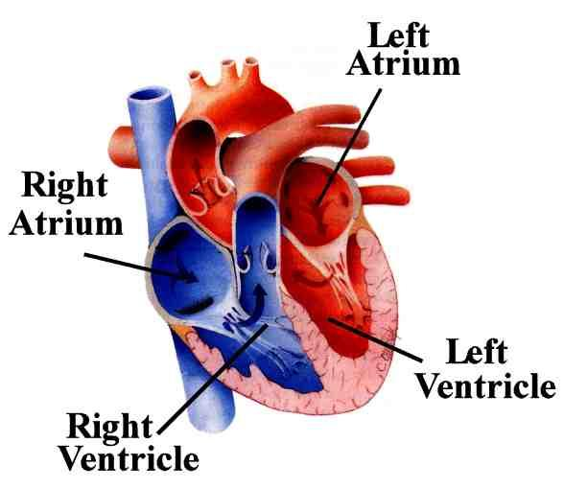
What is aortic valve disease 1?
Image: 1

Slide 2
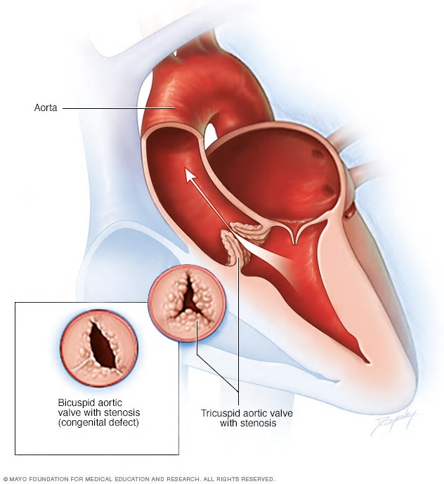
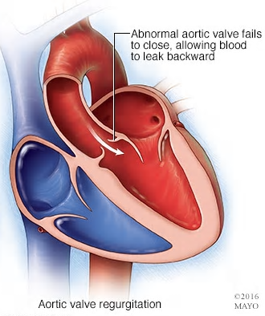
What are the three main phenotypes?
Image: 2

Slide 3
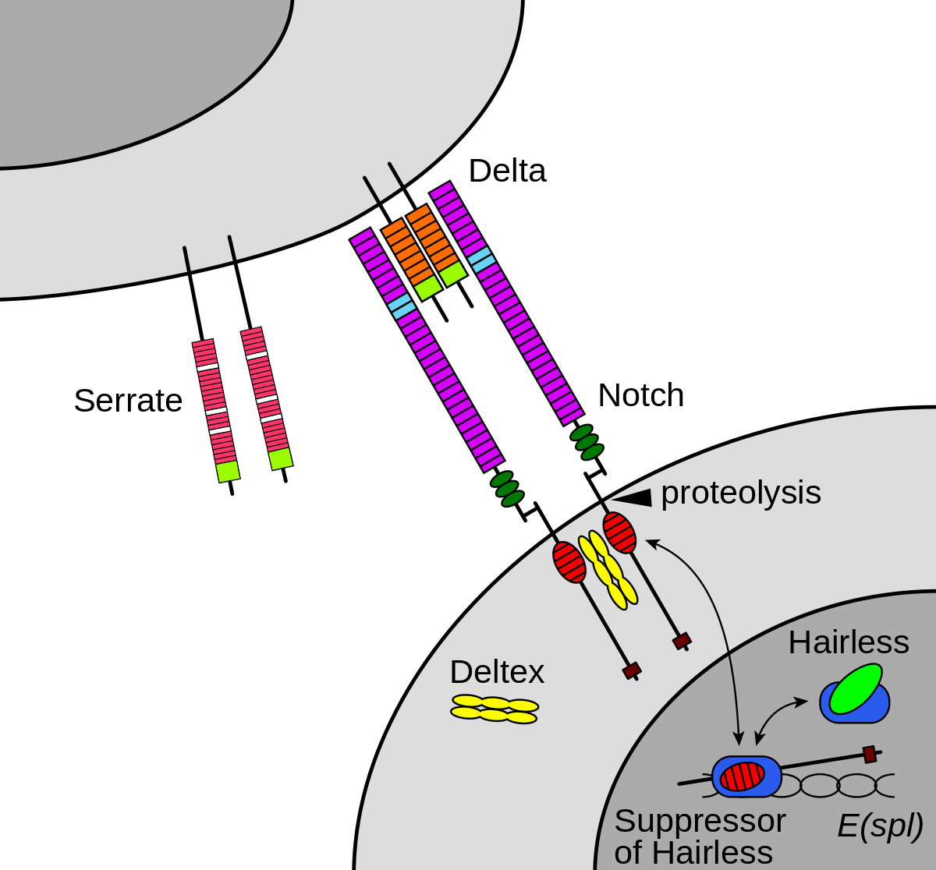
How is NOTCH1 involved?
Image: 3

Slide 4
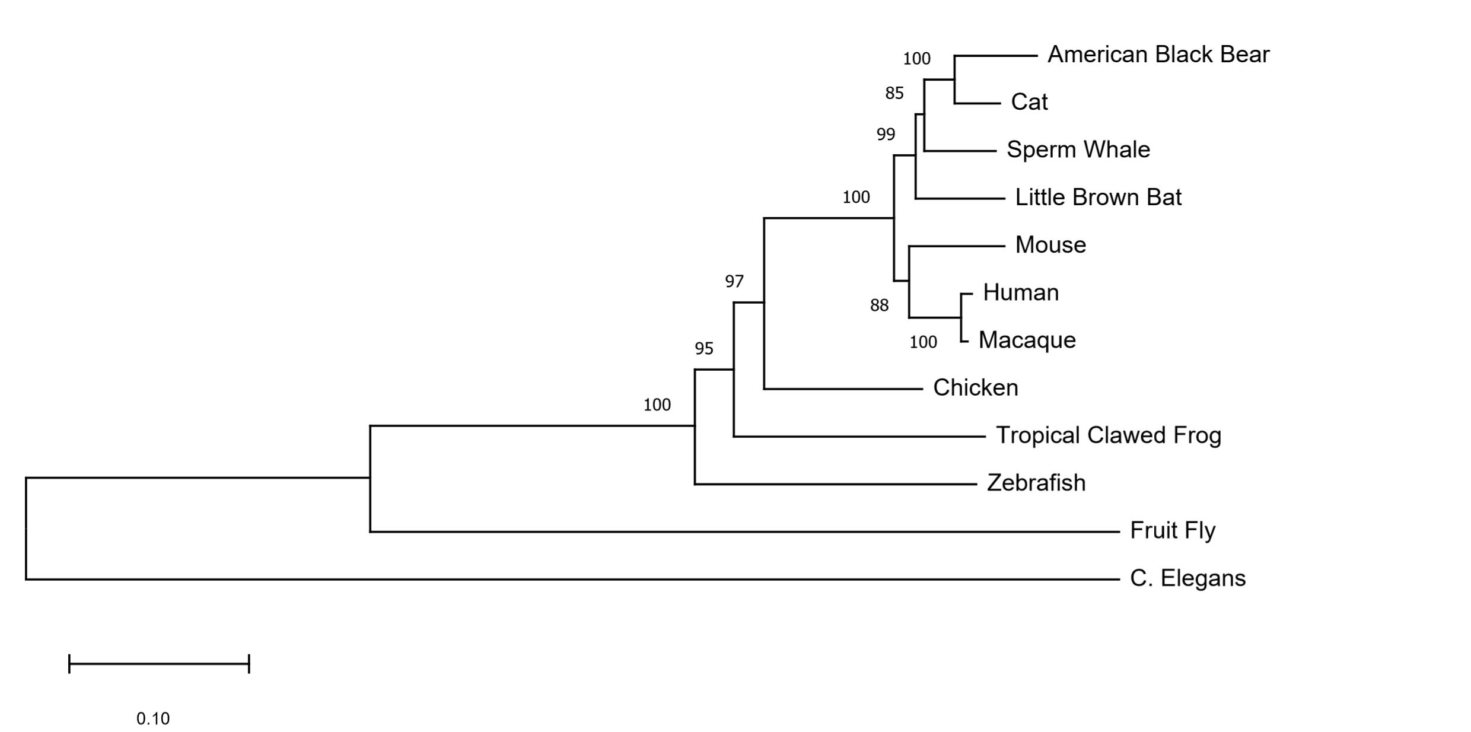
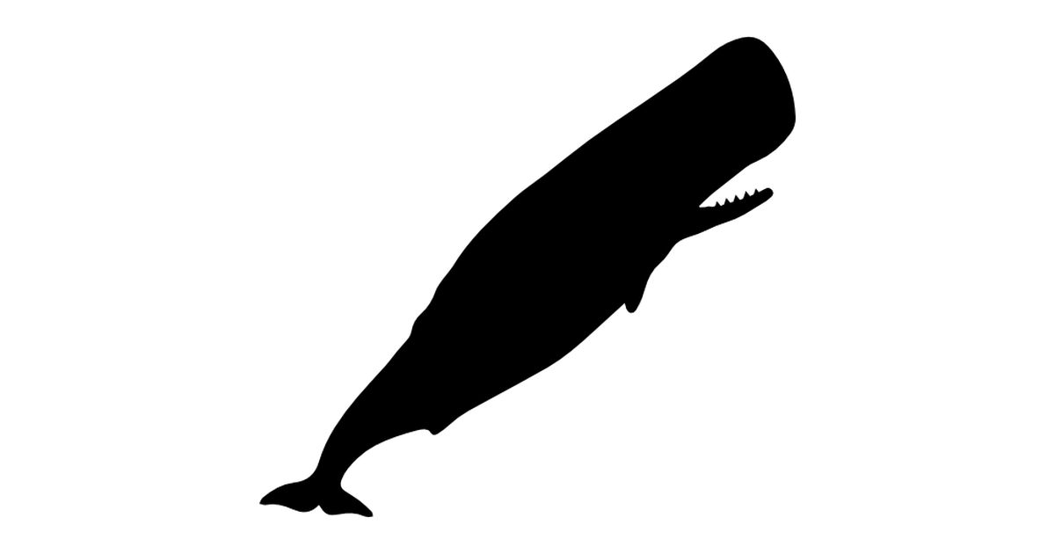
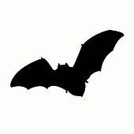
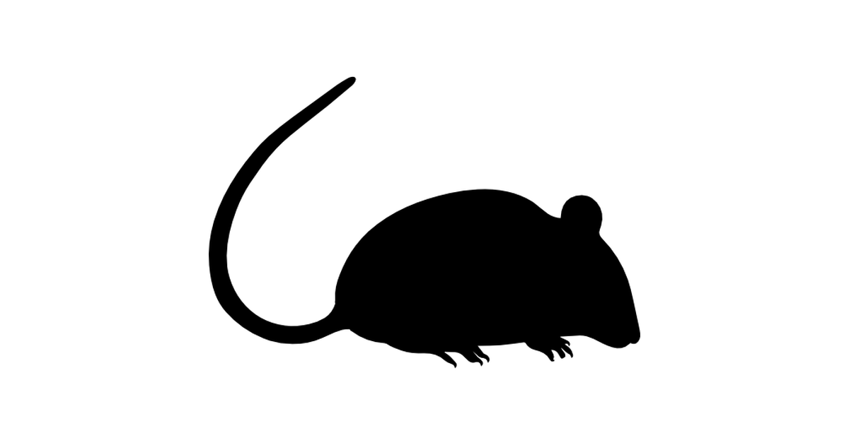
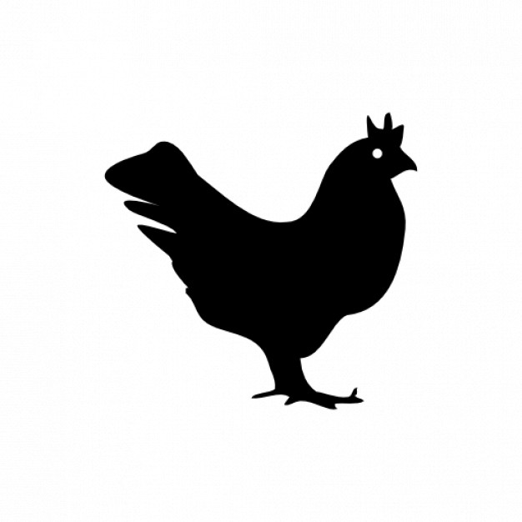
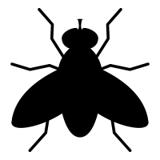
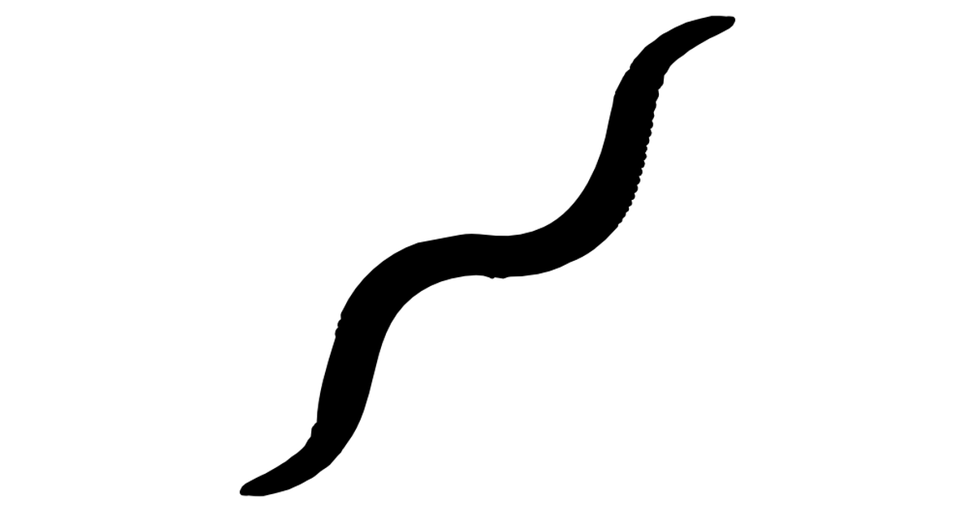
How has NOTCH1 evolved?
Muscle aligned neighbor-joining method
Images: 4-15

Slide 5
NOTCH1 is a conserved transmembrane receptor
2555 AA -%
EGF and EGF CA
NL
NOD
NODP
ANK
DUF
Human
2531 AA 90.73%
Mouse
2436 AA 67.03%
Zebrafish
2703 AA 49.37%
Fruit Fly
1429 AA 27.67%
C. Elegans
Via SMART: 16

Slide 6
What are the major NOTCH1 isoforms?
2555 AA
EGF and EGF CA
NL
NOD
NODP
ANK
DUF
NOTCH1
2471 AA
NOTCH2
2468 AA
NOTCH3
2003 AA
NOTCH4
Ligand Binding Regulation/Dimerization Signal Transduction
Via SMART: 16

Slide 7
Common aortic valve disease 1 mutations
P1390T
A1343V
EGF and EGF CA
NL
NOD
NODP
ANK
DUF
R1350L
P1377S
Via JTCVS: 17

Slide 8
What are the top NOTCH1 motifs?
Via MEME: 18

Slide 9
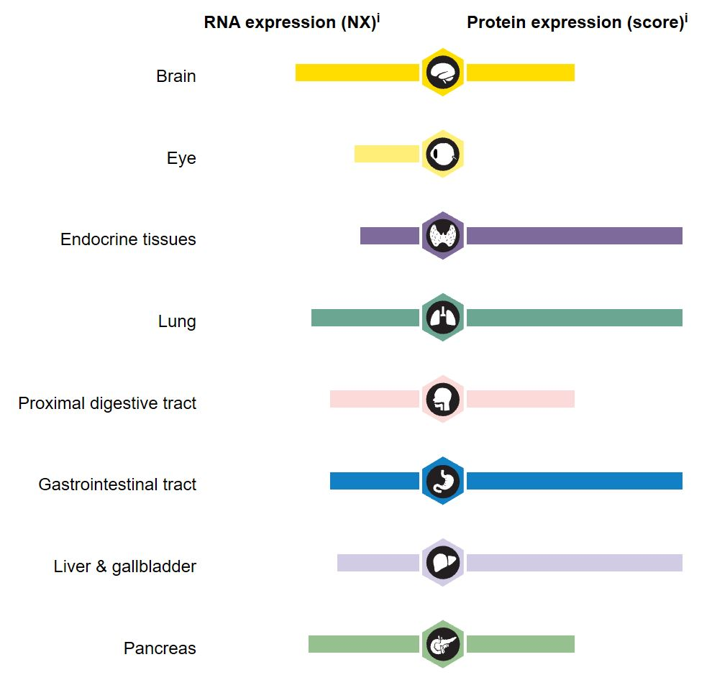
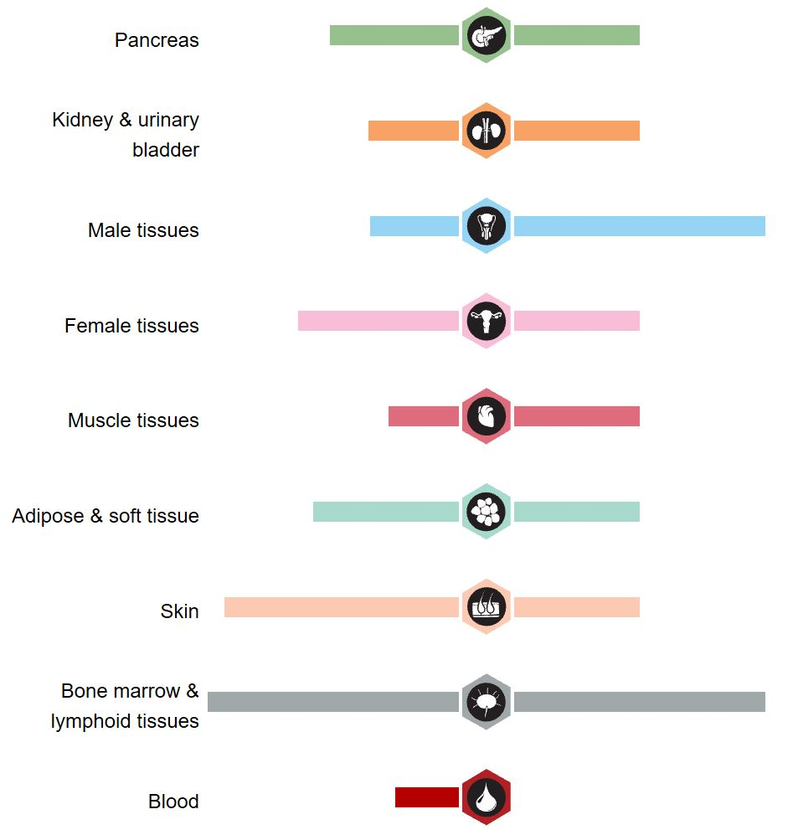
Where is NOTCH1 expressed?
Via HPA: 19

Slide 10
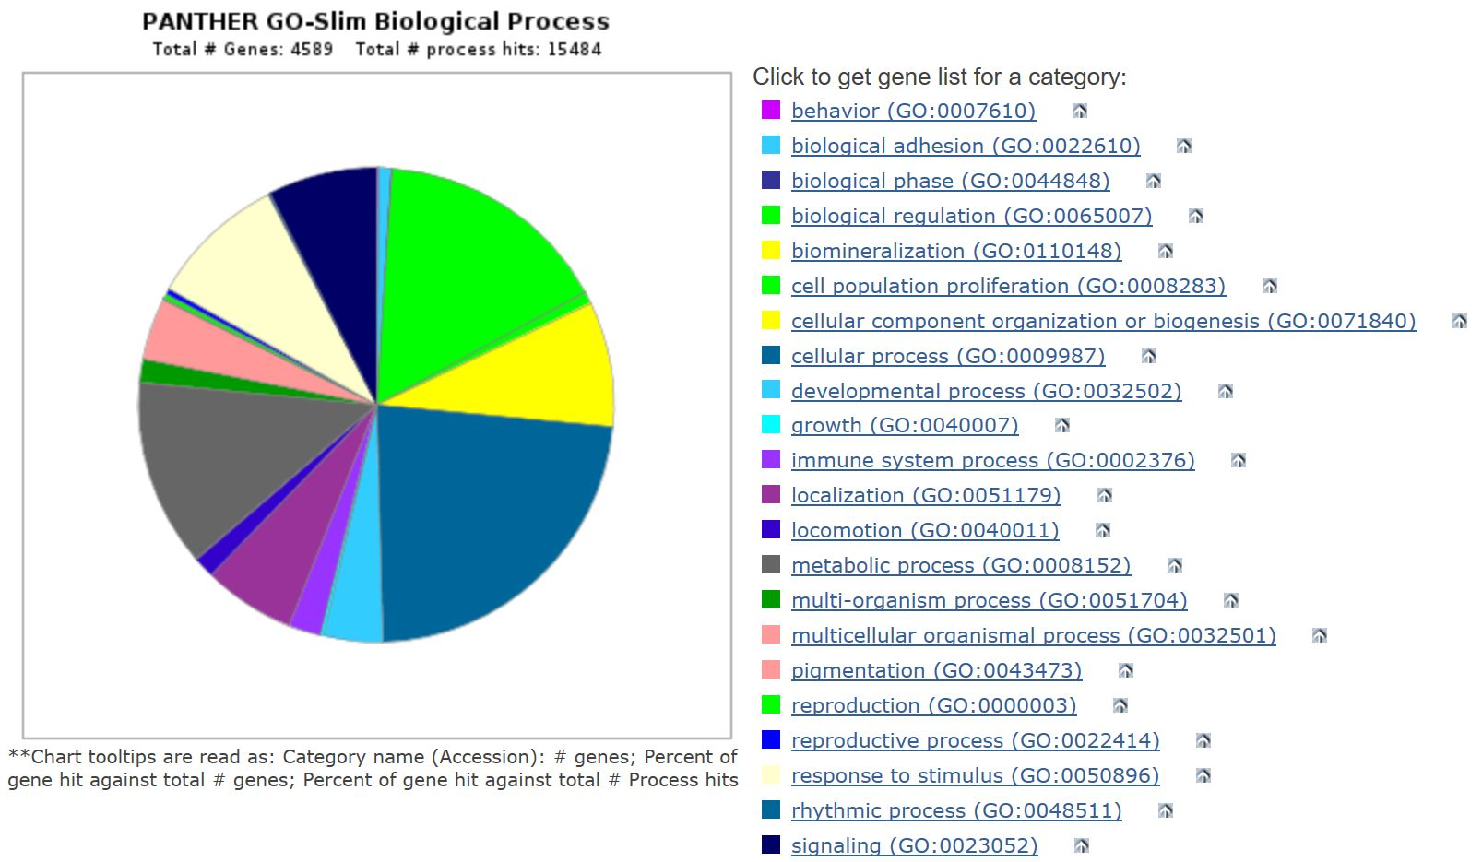
What biological processes is NOTCH1 involved in?
Via Panther: 20

Slide 11
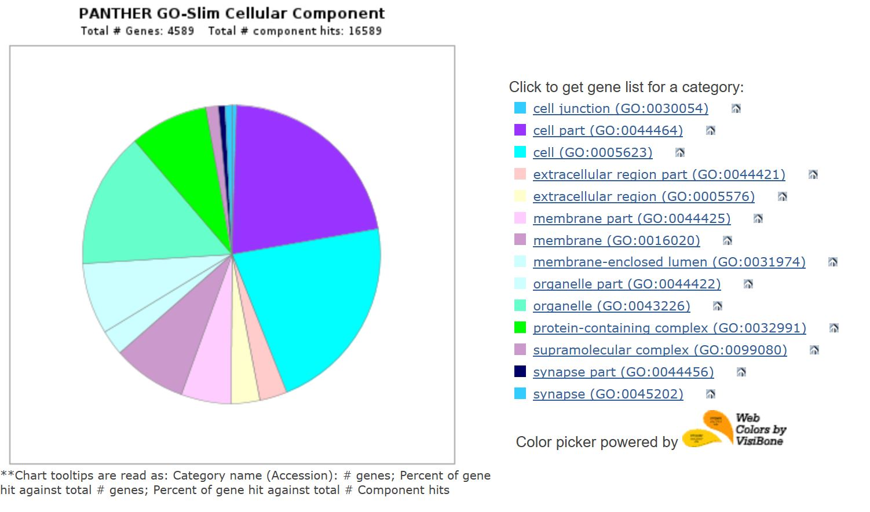
What cellular components are related to NOTCH1?
Via Panther: 20

Slide 12
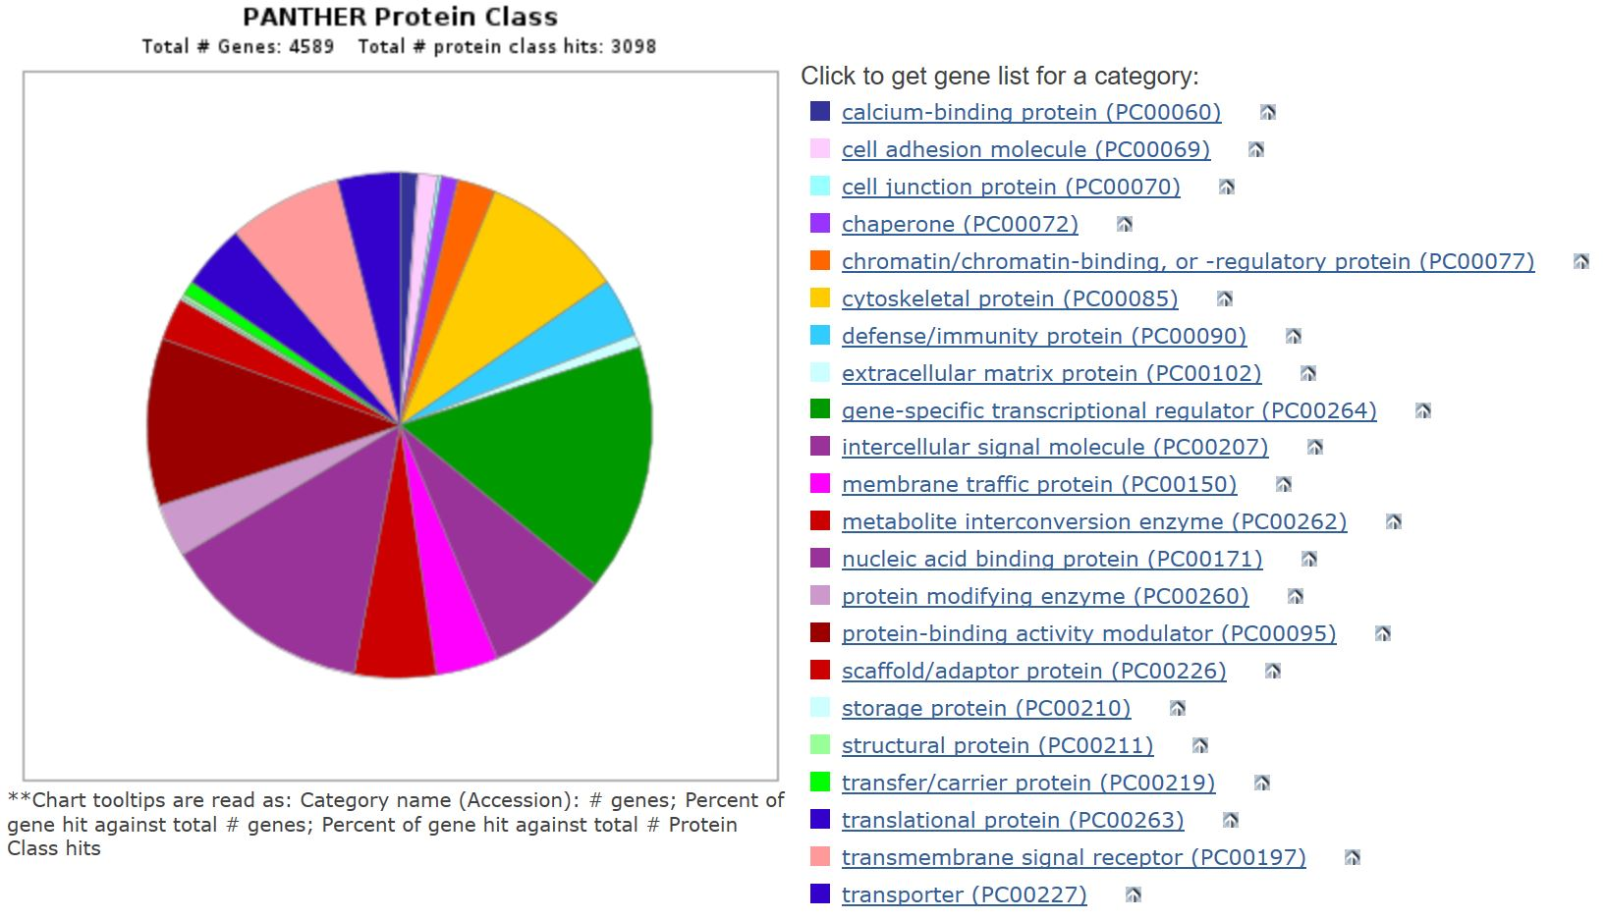
What protein classes does NOTCH1 possess?
Via Panther: 20

Slide 13
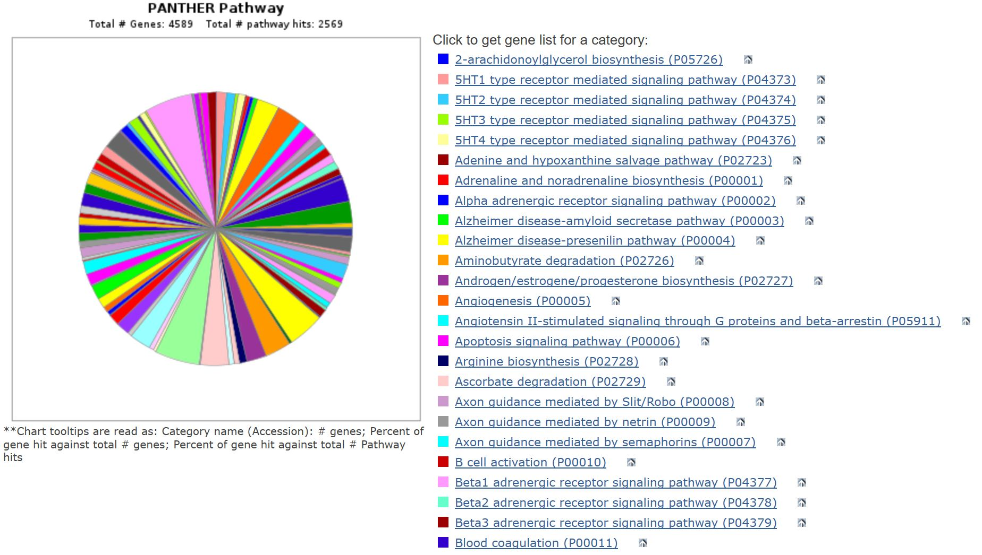
What pathways is NOTCH1 involved in?
Via Panther: 20

Slide 14
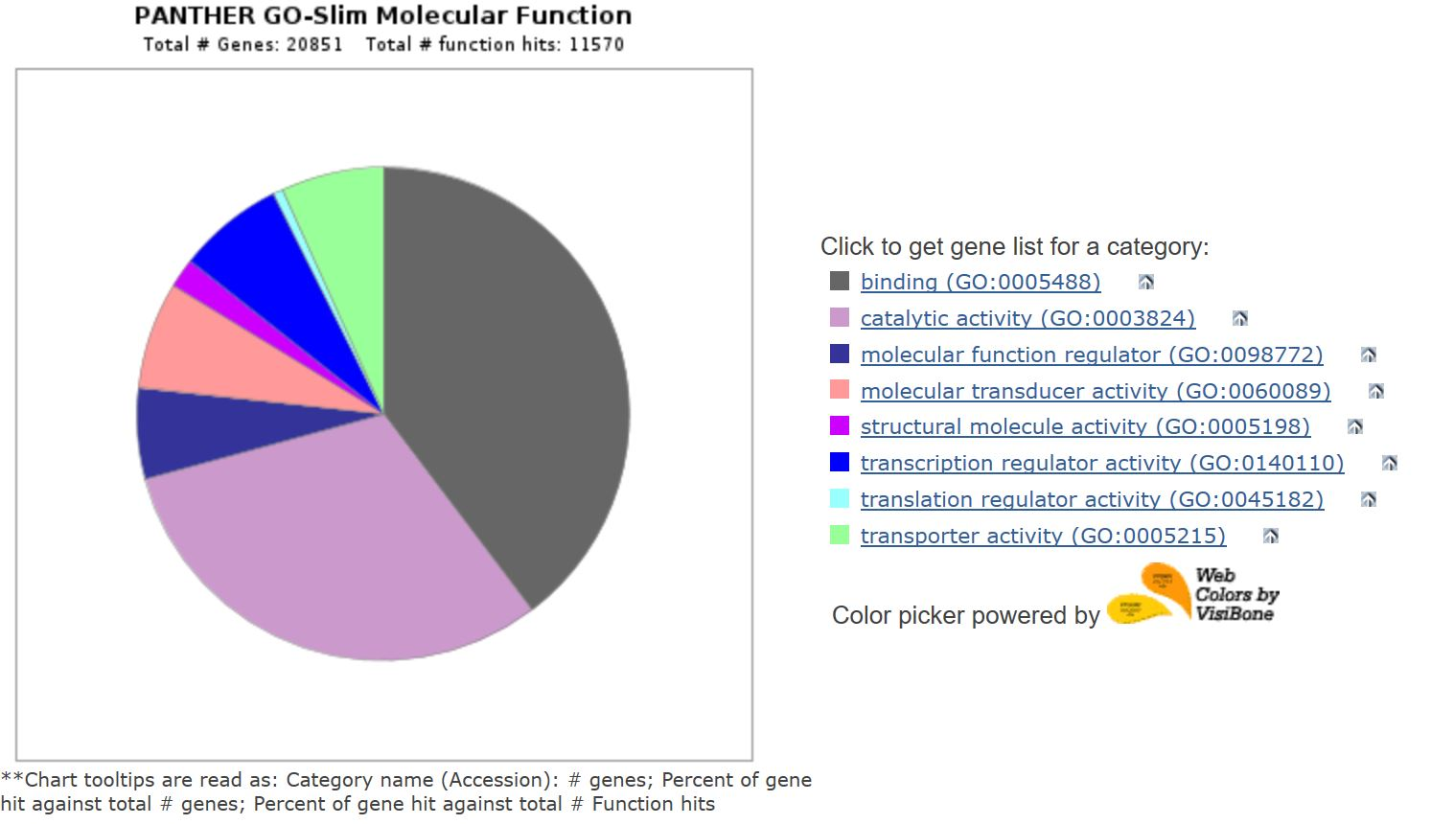
What molecular functions does NOTCH1 carry out?
Via Panther: 20

Slide 15
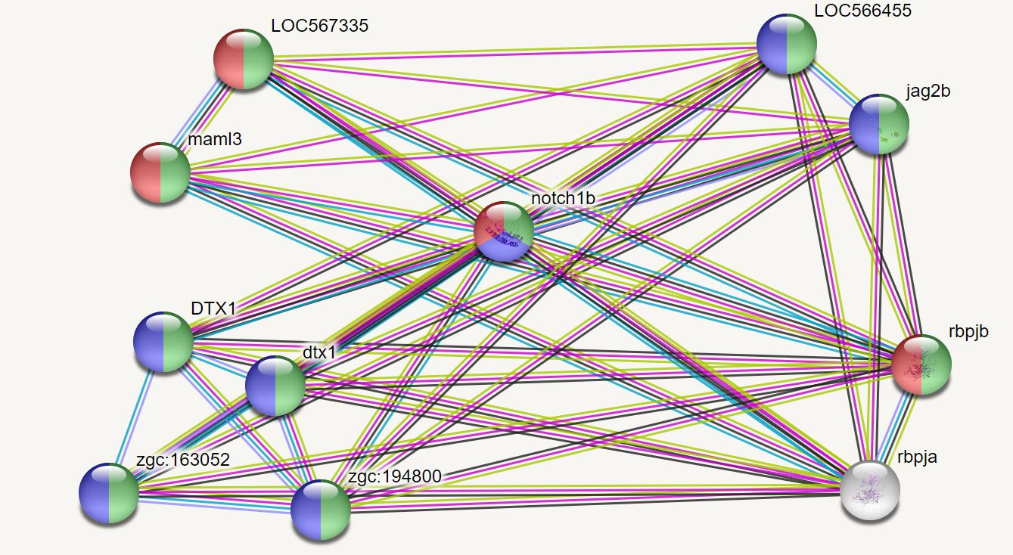
Mastermind-like Transcriptional Coactivators
NOTCH Ligands
Immunoglobulin Recombination Signal Proteins
E3 Ubiquitin Ligases

Slide 16
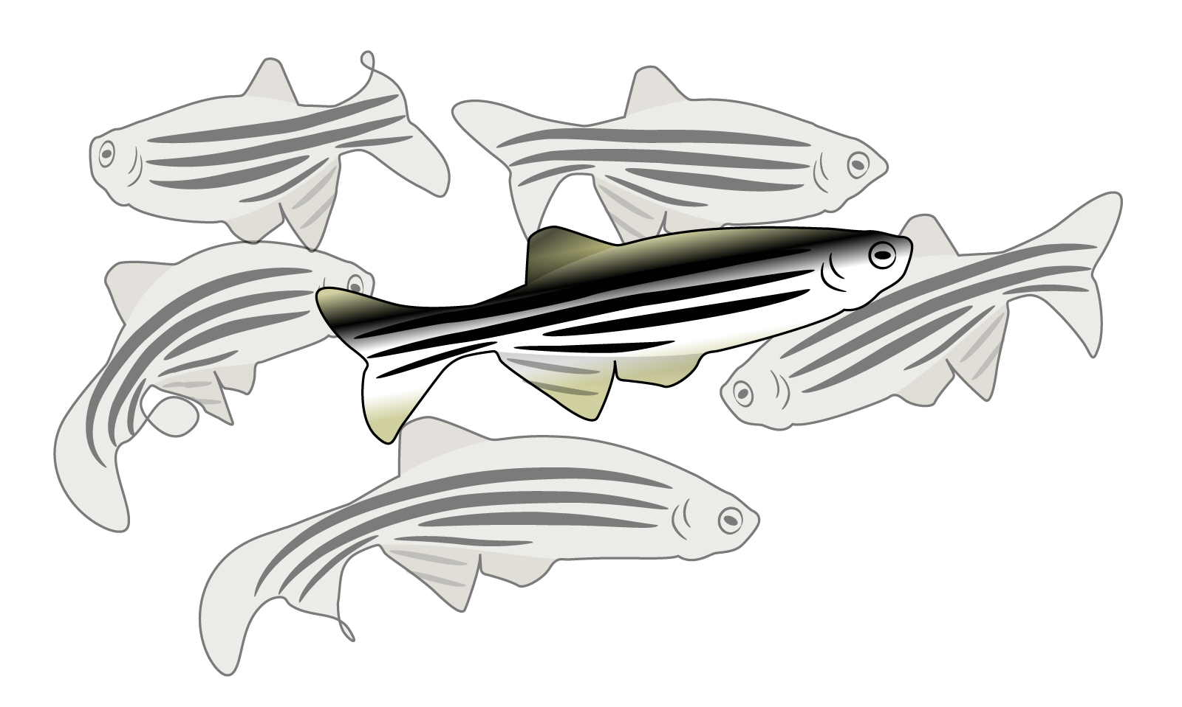
Why use zebrafish to model AoVD1?
Homology, similar cardiovascular system, easy phenotypic visualization
Image: 21

Slide 17
Aim Visualization
What type of mutation and in what location in NOTCH1 distinguishes one class of AoVD1 phenotypes from the others?
Do mutations in the EGF-like calcium binding motifs lead to calcification? Do these mutations initiate a shift in differentiation to osteoblast cells?
Map homology between humans and zebrafish
Mutate conserved domains
Visualize downstream consequences

Slide 18
References
http://www.infobarrel.com/media/image/96105_max.jpg
https://www.mayoclinic.org/diseases-conditions/aortic-valve-disease/symptoms-causes/syc-20355117
https://upload.wikimedia.org/wikipedia/commons/thumb/0/04/Notchccr.svg/1200px-Notchccr.svg.png
https://upload.wikimedia.org/wikipedia/commons/thumb/d/d8/Person_icon_BLACK-01.svg/721px-Person_icon_BLACK-01.svg.png
https://image.freepik.com/freie-ikonen/bar-seitenansicht-silhouette_318-42619.jpg
https://image.flaticon.com/icons/svg/47/47197.svg
http://imageog.flaticon.com/icons/png/512/47/47096.png?size=1200x630f&pad=10,10,10,10&ext=png&bg=FFFFFFFF
https://photos.gograph.com/thumbs/CSP/CSP418/bat-silhouette-stock-illustration_k19082699.jpg
http://imageog.flaticon.com/icons/png/512/47/47240.png?size=1200x630f&pad=10,10,10,10&ext=png&bg=FFFFFFFF
https://image.freepik.com/free-icon/monkey_318-62892.png
https://image.freepik.com/free-icon/chicken-symbol_318-10389.jpg
https://image.shutterstock.com/image-photo/image-450w-59417659.jpg
https://media.istockphoto.com/vectors/vector-set-of-black-aquarium-fish-silhouettes-with-text-vector-id1145856310?k=6&m=1145856310&s=612x612&w=0&h=gOnb4kwuztGEmfrxQpe4RoNNW3OkwoTyLOnIHelnWYE=
https://d30y9cdsu7xlg0.cloudfront.net/png/40840-200.png
https://imageog.flaticon.com/icons/png/512/47/47217.png?size=1200x630f&pad=10,10,10,10&ext=png&bg=FFFFFFFF
http://smart.embl-heidelberg.de/
https://www.jtcvs.org/cms/attachment/2005342247/2022983670/gr3.jpg
http://meme-suite.org/
https://www.proteinatlas.org/
http://pantherdb.org/
https://www.genome.gov/sites/default/files/tg/en/illustration/zebrafish.jpg

